Slide 1
Ending Violence Against Women: Inculcating the review of Femicide and other cases in the Criminal Justice System
18th September 2024
Lynne Carlin, Assistant Director

Slide 2
Domestic Abuse
Domestic abuse is a term used to describe a range of behaviour often used by one person to control and dominate another with whom they have, or have had, an intimate or family relationship.
“…threatening, controlling, coercive behaviour, violence or abuse (psychological, virtual, physical, verbal, sexual, financial or emotional) inflicted on anyone (irrespective of age, ethnicity, religion, gender, gender identity, sexual orientation or any form of disability) by a current or former intimate partner or family member.”
PUBLIC PROSECUTION SERVICE

Slide 3
PUBLIC PROSECUTION SERVICE
2023 - 33,071 reported domestic abuse incidents
17 homicides, 8 women as a result of domestic abuse
Ending Violence Against Women and Girls Strategy; Stopping Domestic and Sexual Violence and Abuse Strategy
Domestic Abuse and Civil Proceedings Act (Northern Ireland) 2021
Course of abusive behaviour- includes controlling or coercive behaviour, psychological abuse, emotional abuse, financial and economic abuse
Policy for Prosecuting Cases of Domestic Abuse (2024) | Public Prosecution Service for Northern Ireland (ppsni.gov.uk)

Slide 4
PUBLIC PROSECUTION SERVICE
Domestic Homicide Reviews
Section 9 of the Domestic Violence, Crime and Victims Act 2004
A ‘domestic homicide review’ is a review of the circumstances in which the death of a person aged 16 or over has, or appears to have, resulted from violence, abuse or neglect by
a person to whom they were related;
a person with whom they were or had been in an intimate personal relationship; or
a member of the same household.
Aim – to prevent future domestic homicides by establishing the lessons learned

Slide 5
PUBLIC PROSECUTION SERVICE
Independent chair- appointed by DOJ
Panel of representatives from statutory and voluntary and community organisations
Panel gather and review information pertinent to the case
Learning within and between organisations to improve services and to identify the actions needed to change practice where issues are identified.
Can recommend changes to policies and procedures where required
Identifies good practice as well as issues

Slide 6
PUBLIC PROSECUTION SERVICE
Chair has power to issue requests for information to any organisation, agency or individual which it believes may have had involvement with the victim, alleged perpetrator and their family;
Chair can invite, on a case-by-case basis, any organisation to join a DHR panel and request that any organisation completes an Internal Learning Review (ILR)
PPS is not one of the specified organisations under the 2004 Act required to establish or participate in a DHR
3 ILR conducted to date, more in progress

Slide 7
PUBLIC PROSECUTION SERVICE
A Domestic Homicide Review will not:
determine how the victim died or who was culpable
apportion blame
form part of a disciplinary inquiry or process
include an analysis of individual prosecutorial decisions
Ongoing criminal proceedings must not be compromised- paused or restricted scope
Panel must inform police and prosecution if speak to witnesses

Slide 8
PUBLIC PROSECUTION SERVICE
Internal Learning Review
Aim of the Internal Learning Review (ILR) is to:
look at individual and organisational practice and context
identify if practice needs to be changed or improved,
support professionals to carry out their work to the highest standards and achieve the best outcome;
identify how and when those changes or improvements will be brought about; and
identify examples of good practice within agencies.
Purpose of the ILR is to identify learning points for the organisation not to dissect individual cases retrospectively

Slide 9
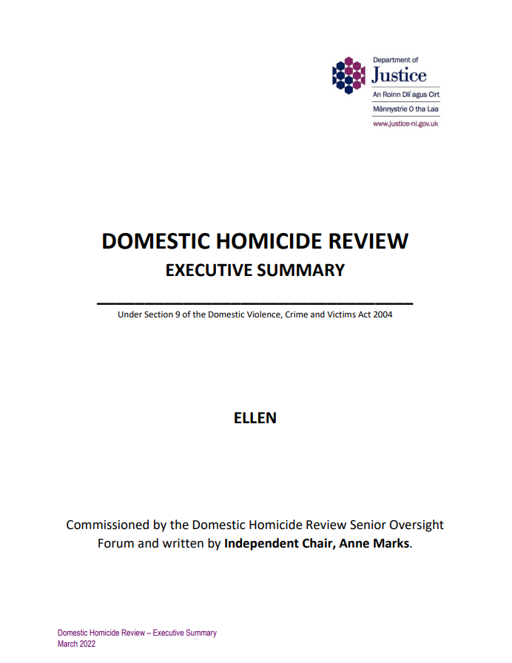
PUBLIC PROSECUTION SERVICE
3 ILRs to date
Reports from concluded reviews published
“Ellen” – murdered by adult son
History of physical and emotional abuse
Identified as at high risk of domestic
abuse
"Chances to intervene were missed and responses were inadequate."

Slide 10
“Amy”- murdered by partner
Known domestic abuser
No reported violence in relationship
Threat of harm posed pre-existed relationship
Chances to intervene missed

Slide 11
"Amy's life and murder highlights the need for organisations and society to radically rethink how to address male violence against women and girls.”
Introduction of the new legislation in NI followed which has changed the way the criminal justice system in NI views and responds to domestic abuse
Enhanced training for police and prosecutors
Domestic Homicide Reviews and lessons learned key strategic priority

Slide 12
More information on our website www.ppsni.gov.uk or by contacting
PPS, Policy and information Unit
Tel: 02890 897100
Deaf/Hard of hearing (SMS): 07795 675528
Email: info@ppsni.gov.uk
Any questions?

