Slide 1
Enforcing the Law: A frontline Approach to combat Environmental crimes, smuggling and Wildlife Crimes
Edward K Chilufya, Department of National Parks and Wildlife

Slide 2
Presentation Outline
Introduction
Wildlife Protected Areas Location
Species of Interest
Poaching Trend
Number of Arrests
Confiscations
Collaboration with other Agencies

Slide 3
Introduction
Department of national Parks and Wildlife(DNPW) is under the Ministry of Tourism
DNPW formed under an Wildlife Act No 14 of 2015
Mandate is to manage Zambia’s Wildlife Resources
Zambia has a vast wildlife estate covering approximately 236,376 sq km
This includes 20 National Parks and 36 Game Management Areas
Tourism in Zambia is dominated by nature-based activities

Slide 4
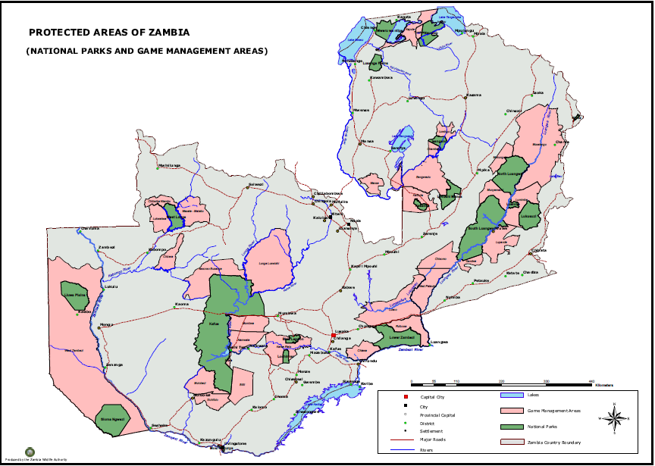
Wildlife Protected Areas Location

Slide 5
Species of Interest
Fauna diversity exceeds 3,600 species, of which 2,032 are invertebrates, 409 fish, 67 amphibians, 150 reptiles, 739 birds, 224 mammals and 598 species of microorganisms
The species of interest include
  Elephant
  Rhino
  Leopard
  Lion
  Pangolin
  Sable and Roan Antelope
  Eland

Slide 6
Poaching Trend

Slide 7
Number of Arrests
Years | Origin of Arrests |  |  | Destination | Cooperation with other Countries
 | Locals | Foreigners | Total
2019 | 4,519 | 39 | 4,558 | China, Congo DR | Nil
2020 | 2,516 | 19 | 2,535 | China, Congo DR | Nil
2021 | 2,990 | 3 | 2,993 | China, Zimbabwe | Nil
2022 | 2,444 | 13 | 2,881 | China, Congo DR, Zambia | Nil
2023 | 2,262 | 46 | 2,308 | China, Congo DRC, Zambia | Nil

Slide 8
Confiscations
No. | Category | 2019 | 2020 | 2021 | 2022 | 2023 | TOTAL
1 | Ivory (Total KGs) | 2,050.25 | 2,344.25 | 2,137.9 | 2,137.9 | 1447.95 | 10,118.25
2 | Rhino Horn (kg) | 1 | 70.7 | 3.92 | 3.92 |  | 79.54
3 | Meat Recovered (Kgs) | 24,1222 | 21,303.56 | 21,629.6 | 21,629.6 | 28,968.06 | 33,4752.82
4 | Military Rifles (Ak47) | 20 | 14 | 8 |  | 4 | 46
5 | Military Rifle (other) | 3 | 1 | 9 | 9 | 4 | 26
6 | Motor bike | 19 | 9 | 67 | 67 | 12 | 174
7 | Boat | 40 | 46 | 39 | 39 | 12 | 176
8 | Boat Engine | 6 | 4 |  | 0 | 7 | 17
9 | Vehicle | 47 | 17 | 35 | 35 | 28 | 162
10 | Live Pangolin | 45 | 89 | 96 | 96 | 49 | 375
11 | Lion skin | 13 | 1 | 3 | 3 | 1 | 21
12 | Leopard Skin | 4 | 17 | 9 | 9 | 3 | 42
13 | Birds (Parrots) | 0 | 0 | 0 | 0 | 97 | 97
14 | Hippo Teeth (kgs) | 9 | 186.9 | 16.5 | 16.5 | 2.9 | 231.8

Slide 9
Collaboration with Other Agencies
Local
  Inter Agency Collaboration Framework on Asset Recovery
  DJOC and PJOC
  National Anti Poaching Task Forces
International
  Transfrontier Conservations Areas (e.g. KaZa, Malawi – Zambia, ZIMOZA)
  Bilateral meeting (JPCDS)
  Combating Wildlife Crimes Network – Malawi, Mozambique, Tanzania & Zambia

Slide 10
THANK you for your attention

