Slide 2
OUTLINE
Background
Purpose
Objectives
Legal Framework
Methodology
Findings
Connection Between Prison Audit Findings and the NPA

Slide 3
BACKGROUND
Jointly launched in November 2022 by the Minister of Justice and the Minister of Home Affairs and Internal Security
Second prison audit (first was conducted 14 years ago)
The data collection team comprised of representatives from various institutions including the ZCS, ZP, Judiciary, LAB and CSOs such as PAN and PRISCCA

Slide 4
PURPOSE OF THE PRISON AUDIT
1. To assess the conditions of correctional centres
2. To assess the extent of awareness and respect for inmates’ human rights in the centres
3. To assess the challenges faced by inmates
4. To assess the amnesty procedures available to inmates
5. To assess the extent to which ‘correctional services’ are implemented and realised following the enactment of the Zambia Correctional Service Act in 2021

Slide 5
OBJECTIVES
To address the bottlenecks in the criminal justice system which contribute to overcrowding in correctional centres
To improve the respect of inmates’ human rights
To enhance the provision of ‘correctional services’, following the enactment of the Zambia. Correctional Service Act in 2021 whose focus is more on rehabilitation than punishment

Slide 6
METHODOLOGY
Adopted a mixed-method research approach that gathered both qualitative and quantitative data
In-depth investigation and understanding of complex and multiple factors associated with overcrowding in correctional centres in Zambia
There were more than 3, 500 participants and respondents in the audit
Out of 87 correctional centres in Zambia, the audit team visited 68 centres: i.e. 52 correctional centres, 10 correctional farms, three remand prisons, two training schools and one reformatory school

Slide 7
Legal Framework
Constitutional state (guarantees civil and political rights in the BoRs)
CEDAW; ICCPR; ICESCR; ACHRPR; ACRWC; CRC; CAT (standards for detainees)
The Nelson Mandela Rules (NMRs)
The ZCS Act domesticated the NMRs in 2021
Prison Rules (1966) which govern the day-to-day running of the correctional centres
Accommodation
Separate accommodation per category- Section 36 ZCS Act & Rule 9(2) Prison Rules
Separate beds, mattresses and beddings which are clean - Rule 21 NMRs & Rule 163(3) Prison Rules
Access to toilets - No legal provision
Bathing and shower installations - Rule 16 NMRs
Drinking water points - Rule 22(2) NMRs
Adequate ventilation - Rule 13 & Rule 14(a) NMRs

Slide 8
Food and Nutrition: Rule 22 NMRs & Rule 24 Prison Rules
Sanitation and Hygiene: Rule 105 Prison Rules
Health and Medical Care:
Establish healthcare facilities - Section 14 ZCS Act & Rule 24 Prison Rules
GRZ to provide healthcare services - Rule 24 of the NMRs
Officer in Charge must inform relatives in case of serious illness - Rule 24 NMRs
ZCS must take preventive measures (infectious diseases) - Rule 108 Prison Rules
Skills Training: education, vocational training, work opportunities, and other forms of support that are suitable and accessible.- Rule 4(2) NMRs

Slide 9
Education:
Right to free basic education - Section 15 Education Act
Education is also compulsory for all illiterate and young inmates - Rule 104 NMRs
All other inmates have the right to ‘part-time education’; mandatory to have a library- Rule 227 Prison Rules
Work: Sentenced inmates should be given the opportunity to work and actively participate in their rehabilitation - Rule 96 NMRSs
Worship and Religion: Freedom of worship - Article 19 of the Constitution
Counselling: Provide comprehensive counselling services for inmates - Section 51 ZCS Act
Recreation: offer recreational and cultural pursuits for a minimum of 1hr/day - Rule 105 NMRs
Legal Framework = Very Good

Slide 10
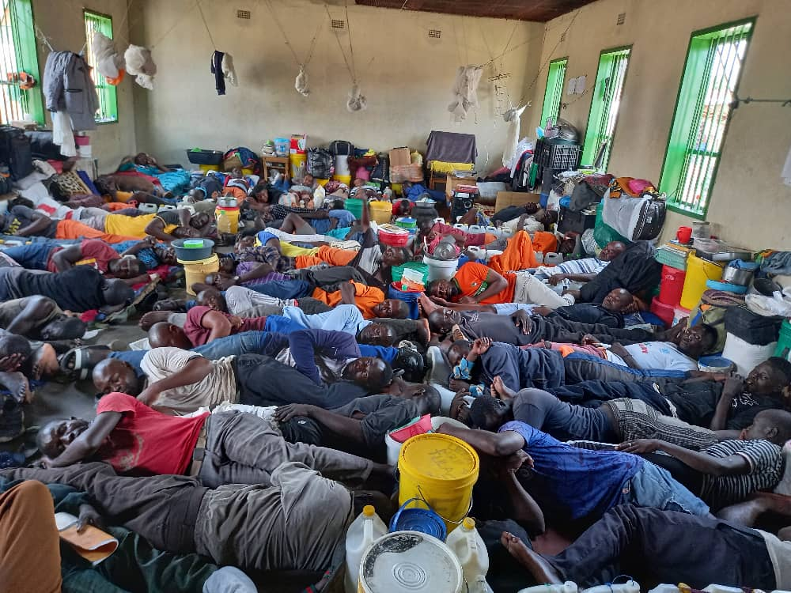
findings
Mansa Correctional Center, 2023

Slide 11
Inmates’ Population = 26,150 as of Mid-May 2023

Slide 12
Average age at the time of arrest - 31 years
The minimum being 12 and maximum 85 years
Level of education- 94 % of inmates lack any form of tertiary education
About 50 % did not go beyond primary education, while 44 % had secondary education and about 6 % had attained tertiary education

Slide 13
Status of Cases
38.8% of the cases are incomplete, 61.2% are complete
Majority among the incomplete =awaiting judgment (40.8%), trial stage (18.5%) and awaiting committal (14.8%)
Intra-Category Gender Distribution

Slide 14
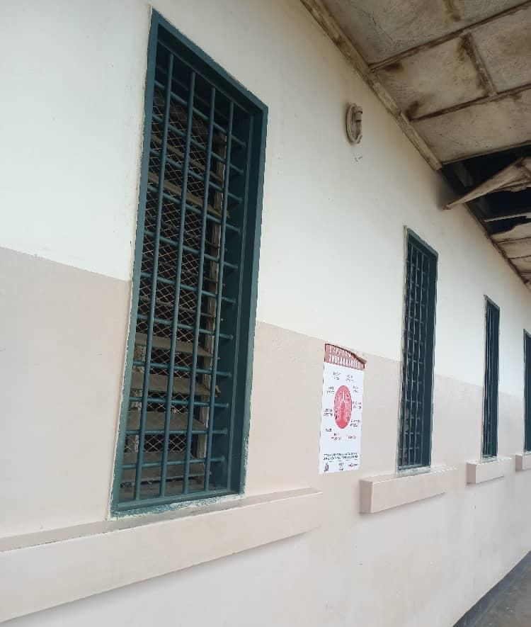
Accommodation
All the 68 facilities - overcrowded
Ventilation
Mainly ranged between poor and fair
Dorms had little ventilation, exacerbated conditions of the sick, and increased risk of contracting communicable illnesses especially during the hot season
Right: Windows and ventilation at Mwembeshi Correctional Facility

Slide 15
Sleeping Space
most of the inmates slept according to their various categories
Constraint - limited infrastructure
Beds, Mattresses and Beddings
beds highly insufficient; few mattresses
Only 35% of inmates slept on mattresses; 65% slept on the floor
Only 51% of inmates had beddings
Sitting Space - General lack of sitting spaces.
“Seriously, how can inmates have where to sit if a dormitory with the initial capacity for 30 inmates in a cell houses 300 inmates?” Male inmate at Ndola Remand Prison
No sitting spaces inside and outside dormitories

Slide 16
FOOD and Nutrition
Is the food ration sufficient?
No -71%
Nutrition-Dietary diversity
Dominance of carbohydrates & proteins, (Beans and Kapenta)
Low intake of vegetables (<25%) and meat
Poorly cooked especially relish
Differential treatment concerning access to food
Biased against remandees
Circumstantial children
Food rationing system insensitive
Age
Sex
Health/medication conditions
Notes:
Food: 2/3 (two-thirds) eat two meals a day, 71% say the food is insufficient, 75% have no access to vegetables therefore inmates have an inadequate intake of vitamins despite being at risk of contracting illnesses due to overcrowding.

Slide 17
Health Care Services
84% reported access to health facility
57% satisfied with services
55 % of Health Facilities had an isolation ward/lobby
Due to congestion and poor sanitation communicable diseases are rampant
Dinning Halls - no designated dining halls
Kitchen - majority have shift facilities; ill-equipped; inmate are made to cook for themselves on firewood
Drinking Water Points
No access to adequate, clean and safe drinking water
54% of the facilities had no taps inside the cells and dormitories; while 33% had one tap inside the dormitories and cells
The ICRC recommends that for every 100 detainees, there should be 1–2 taps

Slide 18
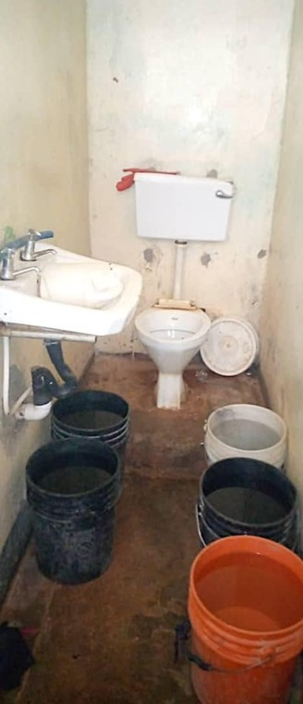
This toilet is in the same place as the source of drinking water –
Kabwe Female Maximum Correctional Centre

Slide 19
Sanitation and Hygiene
Sanitation - worrisome
Hygiene
General hygiene is a major challenge; Multipurpose use of space and items
No facilities for the proper care of inmates’ hair
Low access to soap, toothpaste and detergents
Education
Most children do not have access to education; facilities lack educational resources
Differential treatment of inmates by the ZCS
Shortage of teachers; lack of adequate education infrastructure
Skills Training
Lack of adequate training equipment, infrastructure and instructors
Vocational courses are not taught with an objective to empower inmates but to fulfil ZCS’ obligation to provide skills training

Slide 20
Work and Farming
Inmates work nearly everyday; some from 07:00 – 16:00 hours, without a break
Not remunerated for the work
No distinction between simple labour and hard labour
No certification to recognise inmates’ competence to work
Worship and Religion
88% of the inmates indicated that all religious groups are allowed in their correctional facilities; 64% have access to worship facilities
No infrastructure built specifically for religious activities
Inmates were forced to work on weekends
Places of worship were not accommodative of the needs of PwDs
Female inmates often had no designated place to worship
Counselling
70% of the inmates had counselling services on premises
Not accessible by all inmates – only 60% had used counselling services
Some inmates were unaware of the existence of the counselling service; some facilities lacked them
Recreation
48% of inmates said they took part in a recreational activity
52% of inmates have no access to recreational facilities available to them

Slide 22
CONNECTION BETWEEN THE PRISON AUDIT FINDINGS AND THE NPA
1. Mandate of NPA = to “institute” criminal proceedings on behalf of the State
Custodian of the key to the flood gates that lead to prison
2. Maintenance of rule of law and protection of human rights (Sec 5(f) NPA Act)
Legal Framework = Very Good; Implementation = Very Poor
Sleeping like sardines? Using the same bucket to unblock the sewer and store drinking water? Held in remand for years exceeding punishment if found guilty? Circumstantial children? Sexual violation of children?
3. Ensure fairness and effectiveness in prosecutions (Sec 5(g) NPA Act)
Is it fair to prosecute a child who has stolen two eggs?

Slide 23
4. Enforce international standards (Sec 5(b) NPA Act)
“Prosecutors are the essential agents of the administration of justice, and as such should respect and protect human dignity and uphold human rights, thus contribution to ensuring due process and the smooth functioning of the criminal justice system.”
“The prosecutor’s role is one of great responsibility. Few positions in society are vested with the authority and responsibility to decide on issues fundamental to the administration of justice.”
United Nations Office on Drugs and Crime (UNODC), The Status and Role of Prosecutors, 2014, page 1.
Pursuit of Prosecutorial Excellence!
THE END.

