Slide 1
2024 National Annual Prosecutors Conference, Lusaka, Zambia 16-18 September 2024
UNODC REGIONAL OFFICE FOR SOUTHERN AFRICA
LINDA NAIDOO

Slide 2
REVIEW OF FEMICIDE

Slide 3
KEY QUESTIONS
Is FEMICIDE a problem?
How do we know that?
Can we prevent femicide?
What are we doing to address femicide?
What is femicide?

Slide 4
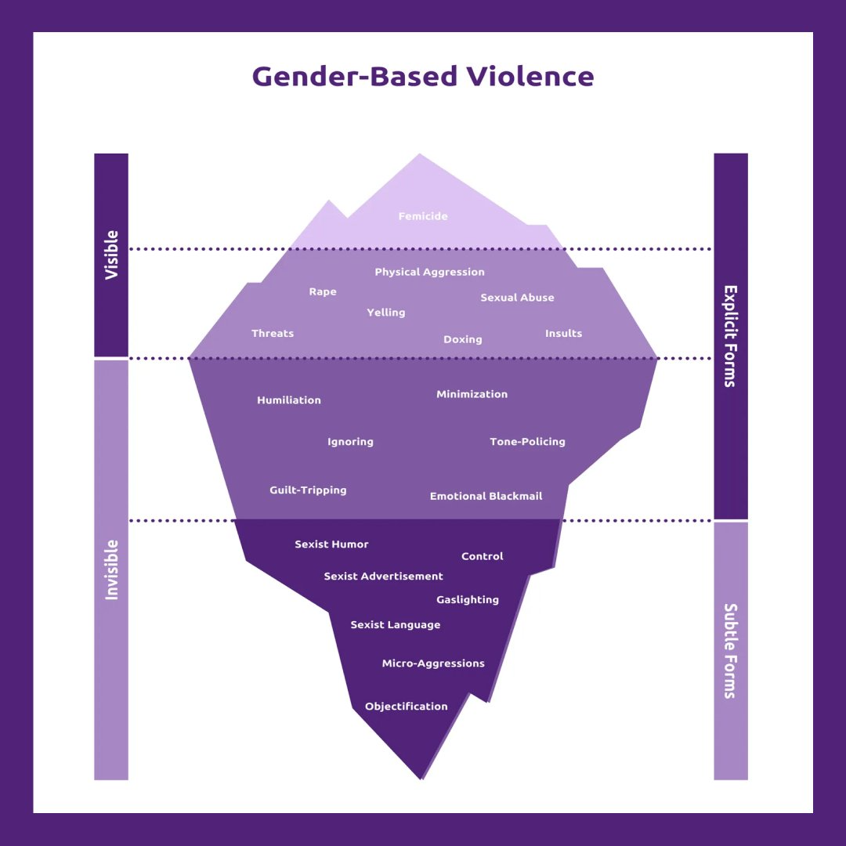
Femicide: tip of the iceberg of GBVAW

Slide 5
Diverse meanings of femicide
Femicide → killing of women because of gender i.e women, girls
Killings by Intimate Partners, family, non-intimate partners
Sexual homicide
Cultural & religious practices: Dowry related killings, honour crimes
Other deaths of women and girls as a consequence of discrimination/identities: unsafe abortion, FGM, LGBTQI+, sex workers, gangs, disabilities etc

Slide 6
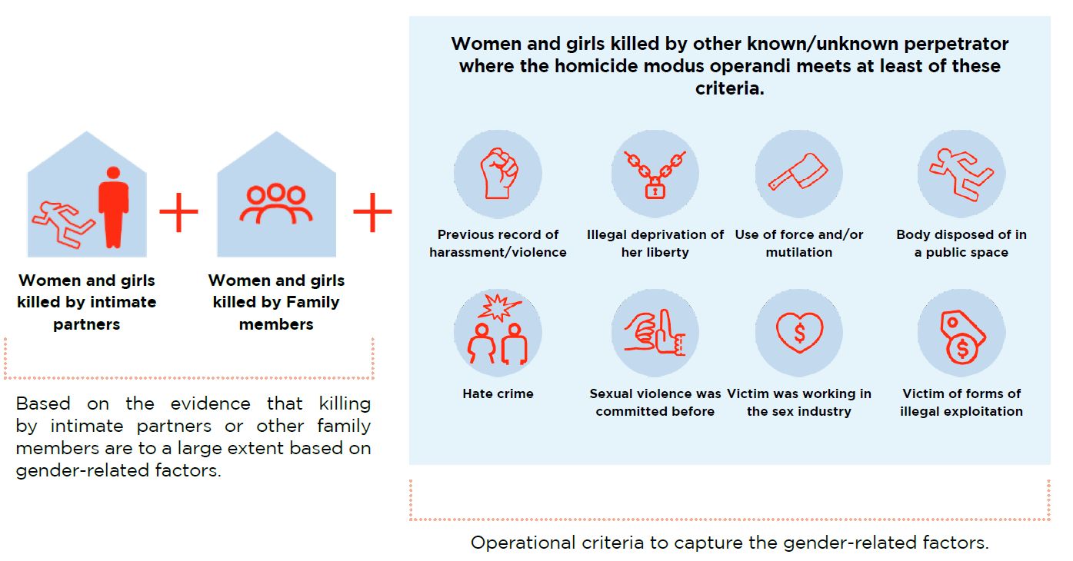
UNODC/ Statistical framework for measuring gender-related killing of women and girls

Slide 7
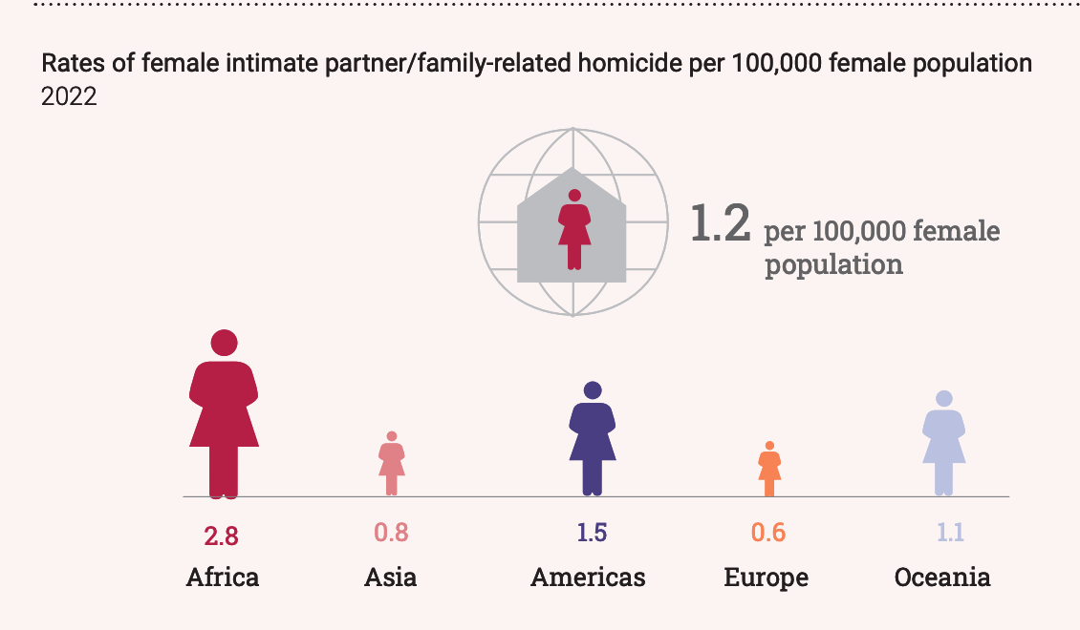
Diversity of challenges & responses to femicide globally
DIVERSITY OF CHALLENGES
Lack of social/political understanding
Lack of / insufficient data
Inadequate investigation / impunity
Inadequate / insufficient measures to prevent / protect
RESPONSES
GBV Prevention strategies (Risk assessment / protection measures)
Legal reform (criminalisation)
Protocols for investigation
Data collection / Femicide observatories
Femicide Reviews / DHR / DVFR

Slide 8
3- PILLAR APPROACH TO WHOLE OF STATE FRAMEWORK (approach promoted by Org Econ Coop Dev. for eliminating GBV on access to justice & accountability)

Slide 9
Legal reform (criminalisation) → CJS
Protocols for investigation → CJS
Data collection / Femicide observatories → CJS / Other sectors
Femicide Reviews / DHR / DVFR → All sectors
Risk assessment / protection measures → CJS

Slide 10
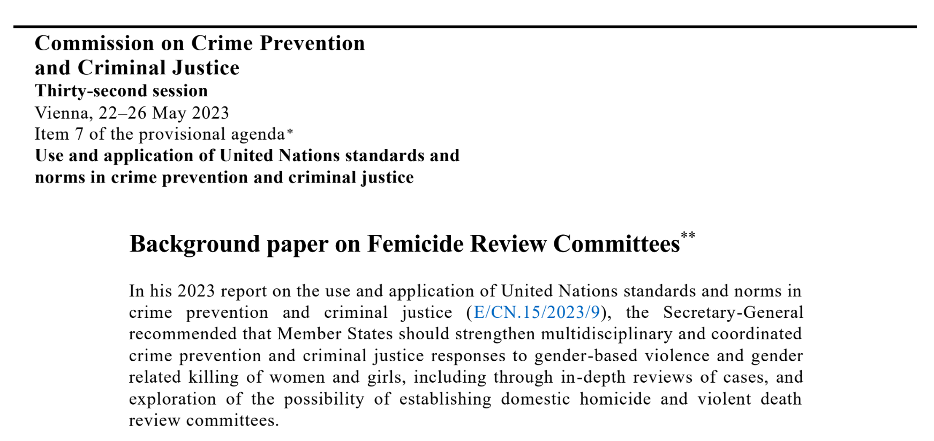
Why Femicide Reviews
Evidence based approach
Notes:
. The SG in his report on use & applic of UN N&S in CPCJ, recommended that MS shud strengthen multidisciplinary & coord CPCJ responses to GBVF through review of cases; est. of Femicide Reviews.

Slide 11
What Femicide Reviews entail ?
Multi-stakeholder reviews
Public, private actors, fostering multi-sectoral coordination and whole-of-state responses to GBVAW.
In-depth analysis of cases → improve States’ responses to GBVAW
Social and institutional attention beyond individual criminal responsibility and CJS responses → social understanding of these crimes as a complex social problem
Involvement of multiple agents, including families, social networks
Potential reparatory impact of femicide reviews
Focus on identifying limitations of existing responses to GBVAW and opportunities for improvement
Notes:
Ministry of Community Development and Social Services

Slide 12
WHY are FEMICIDE REVIEWs needed?
Complement existing legislation and policies on femicide
01
Consider the knowledge, perspectives of families, social networks, faith based, reparatory potential of involvement
02
Reinforce a whole-of-state approach to GBVAW prevention
03
Focus on State responsibility in relation to GBVAW
04

Slide 13
Elements in femicide reviews
Setting up Committees / Teams
Existing multi-agency bodies
Governmental and non-governmental agencies
Characteristics of femicide review committee members
Selection of cases
Opportunity of the review (in relation to criminal proceedings)
Scope of cases
Characteristics of cases
Availability of services
Terms of reference of reviews
Families and social networks of victims and perpetrators
Sectors and agencies part of the review
Time frame of the review
Data, reports and recommendations
Data collection and reports
Recommendations and monitoring
Research
Normative framework
Existing legislation and policies

Slide 14
A WHOLE NEW METHODOLOGY
Requirements for members of review committees
Expertise. Representation. Seniority and independence. Diversity.
Specific requirements for the Chair.
Coordination; Participation of non-governmental organisations, faith-based, Families, communities
Policy

Slide 15
CJS Investigation vs. Femicide reviews (1)
CJS → Individual Criminal Responsibility
Focus → Who, how, when committed the crime; mitigating / aggravating factors
Attribution of guilt (individual)
Limited number of actors (CJS: judiciary, prosecution, defence, witnesses)
Femicide Reviews → Social and institutional Responsibility
Focus → what lessons can be learned? What responses can be improved in order to respond more adequately to GBVAW and prevent these crimes
Non-blaming approach, healing
Broad number of actors: most sectors in government (health, social, children, law enforcement, education, community, faith-based, trad leaders, CSOs etc.)

Slide 16
Femicide Review
Multi-agency review process, involving public and private actors, that is conducted following a femicide (GBVAW killing)
Systematic examination of circumstances surrounding death, to identify what lessons can be learned from them, in order to improve responses to GBVAW & help prevent future deaths
It’s a process separated and different from CJS proceedings.

Slide 17
When: how femicide reviews relate to other legal proceedings?
Conviction / final decision
Killing
Investigation / Trial
Femicide Reviews

Slide 18
Outcomes of femicide reviews
Data and information collected. Ex:
Number of deaths / deaths reviewed
Demographics of victims / perpetrators
Incident characteristics
Risk factors
Final reports / issues of confidentiality / publicity
Recommendations

Slide 19
Impact & challenges
Impact
Improving prevention and social awareness
Improving qualified training
Improving services and risk assessment and management
Promoting self-reflection on practices
Enhancing cooperation among agencies
Challenges
Monitoring and reporting on the implementation of recommendations
Impact assessment
Resources involved
Minoritised groups and communities

Slide 20
Can femicide reviews be introduced in any country or context?
Political will
Safety
Existence of services

Slide 21
THAT'S IT! Thank you!
Whole of society/state approach!!

