Slide 1

Forensic DNA Analysis in Zambia - A Policy Perspective
Annual Prosecutors’ Conference
16 – 18 September, 2024
Brig Gen Prof Lawson F. Simapuka
BSc (HB), MBChB, MPH, MSc (CR), FID, PhD(PH), Pg. DipFMS
Executive Director
National Forensic Authority

Slide 2
Background
The provision of forensic services had, prior to the enactment of the National Forensic Act, remained rudimentary and was fragmented in various Institutions.
These services were narrow in scope, and often resulting in poor resolution of cases.
The identification of perpetrators of sexual crimes was largely based on witness/victim testimonies without corroborative DNA evidence.
This further contributed to poor resolution of cases

Slide 3
Background
To mitigate these challenges, Government enacted the National Forensic Act No. 2 of 2020
The National Forensic Act established three institutions;
  National Forensic Authority (NFA).
  Office of the State Forensic Pathologist (OSFP).
  National Forensic Science and Biometrics Department (NFSBD).
On 5th May a commencement Order was issued through SI No. 36 2021 to operationalize these Institutions.

Slide 4
The National Forensic Authority (NFA)
The main mandate of the NFA is to regulate the practice of forensic science and pathology in Zambia.
Regulation entails that all institutions offering forensic services adhere to minimum set scientific standards in the criminal justice system.
The Act empowers the Authority to develop and enforce standards, guidelines, and regulations related to forensic services.

Slide 5
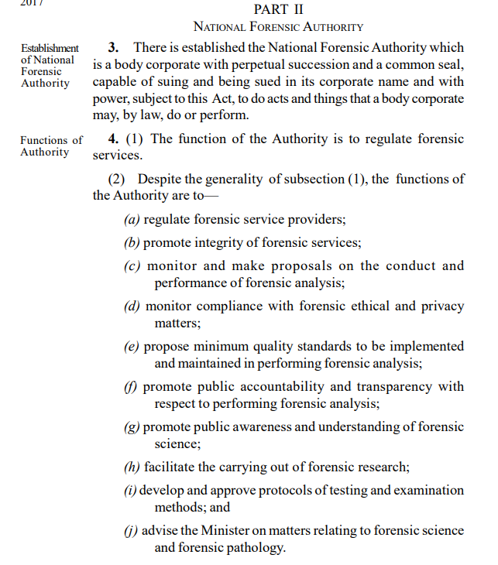
The National Forensic Authority (NFA):
Specific functions of the Authority include;
  Licensing of forensic service providers (Public and Private).
  Developing forensic standards and guidelines.
  Handling and Investigating complaints of abuse / mishandling of forensic matters.
  Undertaking public awareness campaigns on forensic matters.
  Ensuring forensic facilities use validated techniques and equipment.
  Ensuring Forensic facilities use qualified staff to undertake forensic work.
  Facilitating research in forensic fields.

Slide 6
The clients
NFA regulates forensic science services in all Law Enforcement Agencies / Private Institutions in line with the National Forensic Act. No.2, 2020.
National Forensic Authority
Police
DEC
ACC
Anti-Terrorism
DNPW
RTSA
Others/Public
Forensic Science & Pathology

Slide 7
The Office of the State Forensic Pathologist (OSFP)
The main mandate of the Office is to conduct medicolegal death investigations for the Coroner.
Medicolegal death investigations involves incident scene management and conducting of postmortem examinations in all unnatural deaths in order to ascertain the cause and manner of death.

Slide 8
The National Forensic Science and Biometrics Department (NFSBD)
The main mandate of the Department is to conduct forensic analyses for the Law Enforcement Agencies and State Institutions.
It is also mandated to collaborate with the Law Enforcement Agencies in incident scene management.

Slide 9
Forensic DNA analysis in Zambia
The GRZ has in conjunction with various collaborating partners made various advancements in furthering forensic DNA analysis in Zambia ;
  Forensic DNA laboratory was commissioned in 2023 and is operational
  Creation of the DNA population database is underway
  Development of the Forensic DNA database (Combined DNA Indexing System (CODIS) ) has been initiated
  MoU between NFA and the University of Cape Town to facilitate for research and training in forensic science.
  MoU between NFA and National Forensic Science University in India to facilitate for training in various forensic science fields has been initiated

Slide 10
Enhanced Regulatory Framework
The NFA is undertaking a number of key activities aimed at enhancing the regulatory framework to support advancements in Forensic DNA analysis in Zambia. These include;
  Review of the National Forensic Act
  Promulgation of the National Forensic Regulations
  Development of Standards and Guidelines

Slide 11
Review of the National Forensic Act
Cabinet, at its 14th meeting, approved in principle the recommendation by the Minister of Home Affairs and Internal Security to amend the National Forensic Act
With respect to Forensic DNA analysis, amendment of the Act is intended to provide for;
  the establishment and management of forensic databases
  the provision of forensic DNA analysis services to members of public in civil disputes at a fee
  regulation clinical forensic medicine
  Regulation of forensic practitioners

Slide 12
National Forensic (General)Regulations
Considerable progress has been made by the Authority in promulgation of the National Forensic (General) Regulations
This Regulations will pave way for the licensing of the forensic service providers
Licensing will enhance the provision of quality forensic services to the CJS

Slide 13
Standards and Guidelines
The Following Guidelines have been published in the Govt Gazette
  Guidelines on Crime Scene Recovery of Evidential Materials for forensic DNA analysis
  Performance Standards for Pathology Practice in Zambia
The following Guidelines have been submitted for publishing in the Government Gazette;
  Standards and Guidelines for Inspection of Forensic Science Facilities
  Standards and Guidelines for Inspection of Forensic Pathology Facilities
  Forensic Research Ethics Committee Guidelines

Slide 14
Standards and Guidelines
The Following Guidelines are under review
  Guidelines on the Forensic Management of Survivors of Sexual Assault.
  General Crime Scene management Guidelines
  Qualifications Guidelines for Forensic Science Personnel

Slide 15
Prospects
Criminal Justice Information Data Bases;
AFIS – Automated Fingerprint Identification System
NIBIN – National Integrated Ballistics Information Network
CJIS – Criminal Justice Information System

Slide 16
END
Plenary Session

