Slide 1
2024 NATIONAL ANNUAL PROSECUTORS’ CONFERENCE
Presenter Dr Mwansa Kaunda Jonathan
(I do not have any Conflict of Interest)
USAID Stop GBV Now Project

Slide 2
Outline
Introduction
Medical Evaluation
Medical History
Medical Examination
Forensic Examination
Police Medical Report ZP Form 32

Slide 3
5.7%
47%
GBV
Harmful norms
Stigma and discrimination
Discrepancy Statutory/cultural laws
Punitive laws for KPs
Lack of coordination
Inadequate One Stop Centres (OSC)
14% Sexual
38 % Physical
39% Child Marriage
Introduction

Slide 4
Evaluation
The medical evaluation of GBV has several immediate goals.
To identify injuries and/or conditions that require immediate treatment
To screen for / or diagnose sexually transmitted infections
To evaluate for, and possibly reduce the risk of HIV and/or pregnancy
To document findings of potential forensic value

Slide 5
Complete Medical Examination Includes
Medical history
General Physical Examination
Multi-Method Regional examination
Use of magnification
Specialized exam techniques are always required
Collection of forensic material

Slide 6
Medical History
Must be Comprehensive and clear .
1
Documented in survivor’s own words.
2
None speculative.
3
A summary of important positives and negatives always must be included .
4

Slide 7
Medical Examination
Identifies features that corroborate the survivor’s story or provide a rational alternative explanation for the presenting complaint.
Identifies complications of assault/abuse (injuries, infections or pregnancy) requiring immediate medical attention.
Directs focus of forensic evidence collection.
Document findings in a manner that supports any legal actions.

Slide 8
Timing of examination
Acute Examination: within 72 hrs of sexual assault. Window for collecting forensic evidence.
Non-Acute Examination: after 72 hrs of sexual assault. Chances of finding forensic evidence reduced.

Slide 9
Forensic Examination
Forensic goal:
Provide an independent reconstruction of the events in question that is:
Accurate
Objective
Scientifically sound
Evidence-based
DNA is the gold standard
Contact
Identity

Slide 10
⁠Available Forensic technology to prevent/respond to GBV in Zambia:
DNA PCR and Crimelite technologies to identify blood and other biological fluids, material fibres and/or hairs left at the scene or on victims as forensic evidence (e.g., rape or murder).
Digital Forensics/Cybercrimes Analysis (e.g. Celebrite equipment to detect abuse in mobile devices, social media, etc)
Fingerprints (Biometrics) technology. Automated Fingerprint Identification System (AFIS) used to process fingerprints from the scenes to link to possible suspects or perpetrators of crime e.g. rape/murder.

Slide 11
Successes /failures
Successes:
Willingness and desire by the country to use forensic technology as a means to solve GBC’s and other cases.
Failures:
Limited Forensic facilities only available in Lusaka whereas other regions remain with a constrained access to such facilities.
lack of adequate numbers of well trained human resource to collect Forensic evidence.
Lack of an established DNA Population Database leading to delays in finalizing cases and an increased backlog of cases.

Slide 12
Challenges
Lack of easy access to Forensic facilities for GBC’s in most regions outside of Lusaka.
Lack of adequately trained manpower to conduct these examinations.
Limited public awareness about the importance of the Forensic Evidence in the Criminal Justice System

Slide 13
Recommendations for more effective use of Forensic Evidence
Increased accessibility to Forensic facilities for most GBC’s especially from areas outside of Lusaka
Establish a centralized forensic DNA Population database.
Enhanced public awareness and education on forensic evidence and improve on resource allocation to enable rapid response to GBV crime scenes to prevent tempering or scene deterioration.

Slide 14
Police Medical Report Form ZP 32
Medical Report (ZP Form 32), all other previous forms have been dropped as at 28/07/2023
Gazetted form
All forms of assault
Defilement
Rape cases
All forms of GBV
All criminal matter requiring Medical evaluation

Slide 15
SIGNING ELIGIBILITY
Medical Doctors
Dental Surgeon
Dentist
Medical Licentiates
Clinical Officers
Midwives
Nurses
All Health Practitioners as Stipulated by Act 24 of 2009 section 8(2) and Act 10 0f 2019 (1)

Slide 16
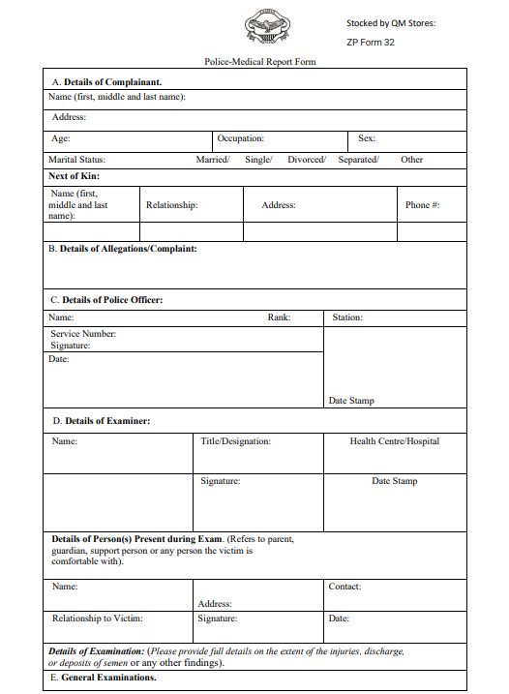

Slide 18
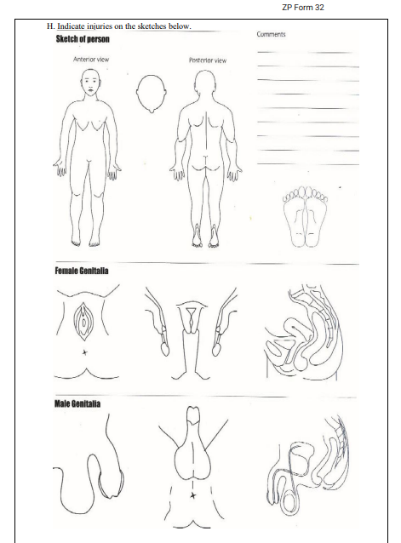

Slide 19
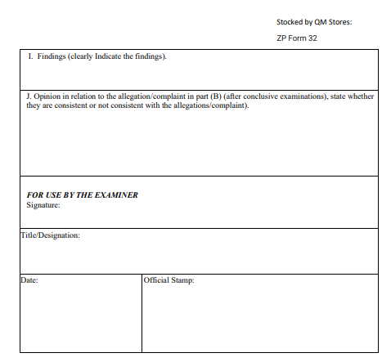

Slide 20
Disclaimer
ZCCP Kwatu Implemented USAID STOP GBV Now Project is made possible by the support of the American People through the United States Agency for International Development (USAID) and the U.S. President’s Emergency Plan for AIDS Relief. The contents of this presentation is the sole responsibility of ZCCP and do not necessarily reflect the views of USAID, PEPFAR or the United States Government.

Slide 21
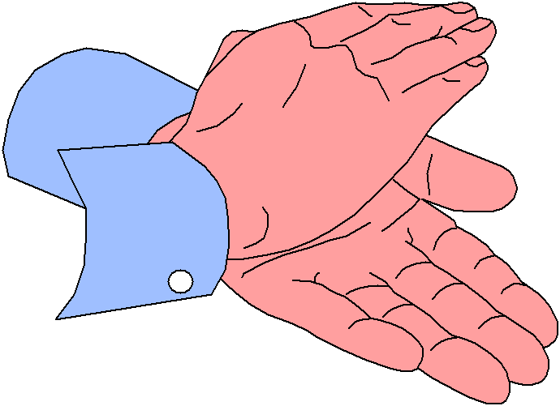
END OF PRESENTATION
Thank You…

