Slide 1



Children, Youth, and Political Caderism in Zambia
A comprehensive guide for law Enforcers, Policy Makers and practitioners during Election
PRESENTED BY
Michael Musumali
WORLD VISION ZAMBIA
March 17, 2026

Slide 2

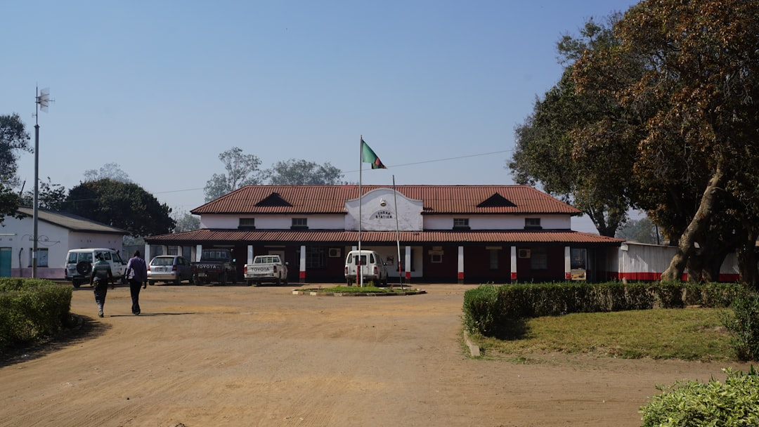


Zambia’s Electoral Context
Democratic Tradition
Youth Vulnerability
Zambia has a rich democratic history, conducting regular elections since independence in 1964, fostering political engagement among citizens and promoting democratic values.
Over 50% of Zambia's population is under 18, making children particularly vulnerable to political exploitation and manipulation during election periods, threatening their welfare.
Electoral Violence Trends
Electoral violence peaked during the 2016 elections, with incidents rising significantly from 2006 to 2021, highlighting the urgent need for protective measures for minors.
Understanding these dynamics is essential for all (Law enforcers, policymakers, CP practitioners) to will help safeguard the democratic processes and protect the rights of young citizens.

Slide 3

Youth Political Engagement Trends in Zambia

Slide 4
Drivers of Youth Involvement Political Violence
1
Poverty and Unemployment
2
Political Manipulation
3 Limited Civic Education
High youth unemployment rates, suggested around 14.5%, push vulnerable individuals towards political activities as a means of survival and economic opportunity.
Adults often exploit youth for political gain, using them as tools in electoral violence, which exacerbates their vulnerability and undermines their welfare.
A lack of comprehensive civic education leaves youth unaware of their rights, making them susceptible to manipulation and involvement in political caderism.

Slide 5

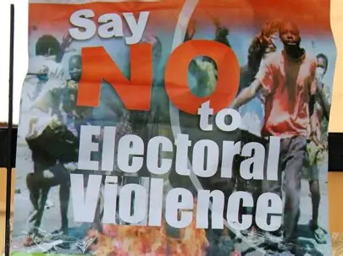
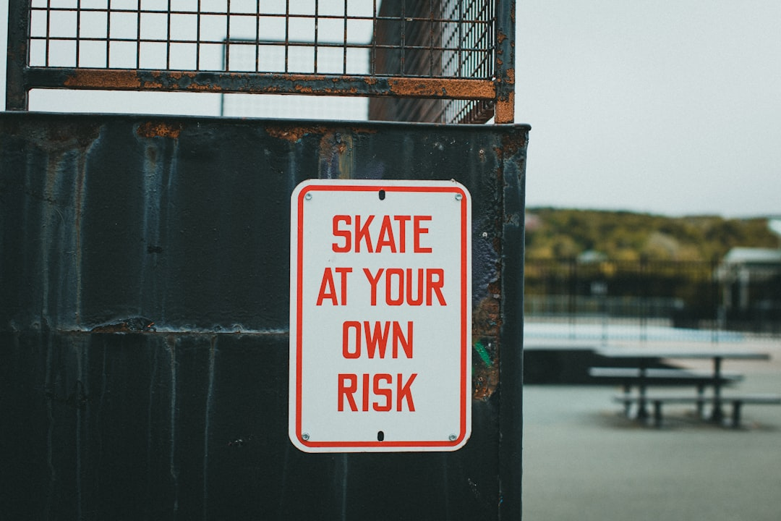
Impact on Children and Youth
Exposure to Violence
Legal Risks
Long-term Consequences
Children involved in political caderism face significant exposure to violence, disrupting their education and leading to long-term mental health issues, including anxiety.
Involvement in political activities can result in legal repercussions for minors, including arrest and criminal charges, which further complicates their future opportunities.
Youth aged 15-29 experience higher rates of violence exposure, leading to social and economic disadvantages that perpetuate cycles of poverty and instability in communities.
Made with SlideMaker.app

Slide 6
Community and Democratic Impact
✓
Increased Electoral Violence
Rising electoral violence in Zambia has led to community unrest, with incidents increasing during election periods, disrupting social harmony and safety.
✓
Fear and Social Divisions
Fear stemming from electoral violence fosters social divisions, undermining democratic processes with citizens report feeling unsafe during elections, reducing voter participation.
✓
Erosion of Trust
Widespread violence erodes trust in political institutions, affecting confidence in electoral processes, threatening the legitimacy of democracy.
✓
Normalization of Violence
The normalization of violence among youth poses a long-term threat to stability, with some citizen viewing political violence as acceptable, perpetuating cycles of unrest.
Made with SlideMker.app

Slide 7
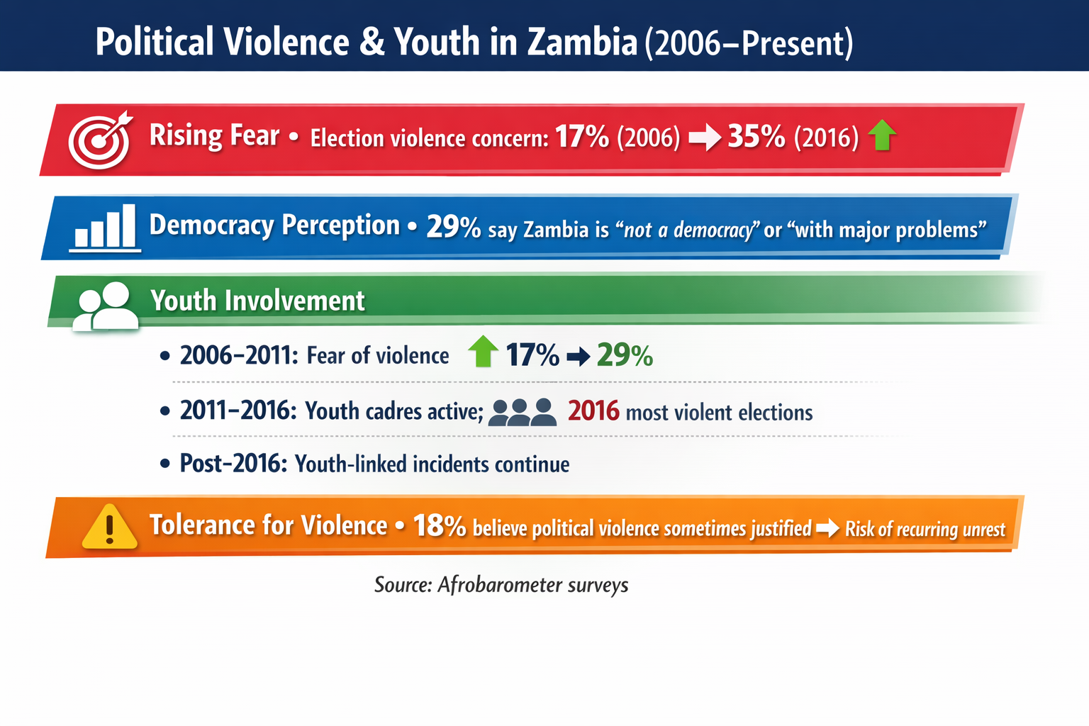

Slide 8






Abuse of the Digital Space During Elections: Impact on Youth and Communities
Zambia’s digital space becomes a battleground during elections with Social media platforms like Facebook, whats up and X amplifying political tensions. (Now powered by AI)
Misinformation, hate speech, and propaganda are spreading rapidly, targeting electorates including young people.
Online political conflict promotes cyber bullying, manipulation and threatening community cohesion and democratic participation.
Misinformation online fosters fear and mistrust, escalating digital conflicts into real-world violence

Slide 9
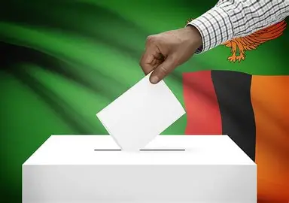
Impact on Youth
Youth are used as amplifiers of political conflict online, often sharing divisive content that escalates tensions within their communities.
Risk of online harassment Increases mental health issues and disengagement by young people from civic participation during elections.
Online violence Increases polarization and undermines the democratic process and social stability.

Slide 10

Legal and Policy Framework
1
Children’s Code Act
This act safeguards minors' rights, ensuring protection from exploitation and violence. It mandates state responsibility for children's welfare, promoting their best interests in political contexts.
2
Electoral Code of Conduct
Regulates political activities during elections, aiming to prevent violence and protect vulnerable populations. It establishes guidelines for political parties to ensure fair electoral processes.
3
Penal Code Provisions
Criminalizes exploitation and violence against minors, providing legal recourse for victims. However, inconsistent enforcement limits its effectiveness, leaving many children unprotected.

Slide 11

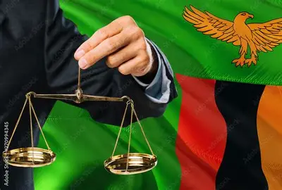

Safeguarding of Children and Youth During Elections
ENFORCEMENT OF CHILD LAWS
Prosecutors must effectively enforce child-protective laws to safeguard minors from political exploitation, ensuring that legal frameworks are actively applied during electoral periods.
PROSECUTION OF EXPLOITERS
It is crucial for prosecutors to hold accountable adults who exploit minors in political contexts, thereby deterring future violations and protecting vulnerable youth.
CHILD-SENSITIVE JUSTICE PRACTICES
Promoting child-sensitive justice practices is essential for ensuring that legal proceedings consider the unique needs and rights of children involved in political cases.
COLLABORATION AND COORDINATION
Effective coordination with other key partners enhances the impact of legal actions, fostering a collaborative approach to protect children from political caderism.
Madewith SlideMaker.app

Slide 12

Prevention Strategies for Youth Involvement
CIVIC EDUCATION INITIATIVES
Empowering youth with knowledge of their rights fosters informed participation. Programs should focus on electoral processes and the importance of peaceful engagement in democracy.
YOUTH EMPOWERMENT PROGRAMS
Enhancing skills and leadership through targeted programs can reduce vulnerability. Initiatives should include vocational training and mentorship to promote self-sufficiency and resilience.
STRENGTHENING CHILD-PROTECTION SYSTEMS
Robust child-protection frameworks are essential for safeguarding minors. This includes effective reporting mechanisms and enforcement of existing laws to prevent exploitation.
ENGAGEMENT WITH POLITICAL PARTIES
Collaboration with political entities is crucial for integrating child-safeguarding measures. Political parties must commit to protecting youth from exploitation during electoral campaigns.

Slide 13
Recommendation on Political Violence and Caderism
Youth Engagement Strategies | Community Resilience Building | Policy Reform Advocacy | Increase Investment in the criminal Justice system | Coordination and Collaboration
Develop targeted programs that empower youth to participate positively in political processes. | Foster community initiatives that promote dialogue and reduce tensions related to political Caderism. | Advocate for policies that protect youth rights and promote democratic values in Zambia. | Enhance process improvement and built public confidence in the legal institutions, which is vital for democracy | Effective coordination with other key partners will enhance the impact of legal actions and protect children from political Caderism.

Slide 14






To safeguard democracy, it is crucial to protect children from political exploitation and violence.
The persistent threat of electoral violence underscores the urgency for immediate call to action by all.
Together, we can build a safer environment for our young people and ensure the integrity of Zambia's democracy!.

