Slide 1


Strengthening Electoral integrity: The Strategic Role of Court Users Committees
Alloys Kemo, OGW
Secretary, Prosecution Services-Kenya
17th March, 2026

Slide 2
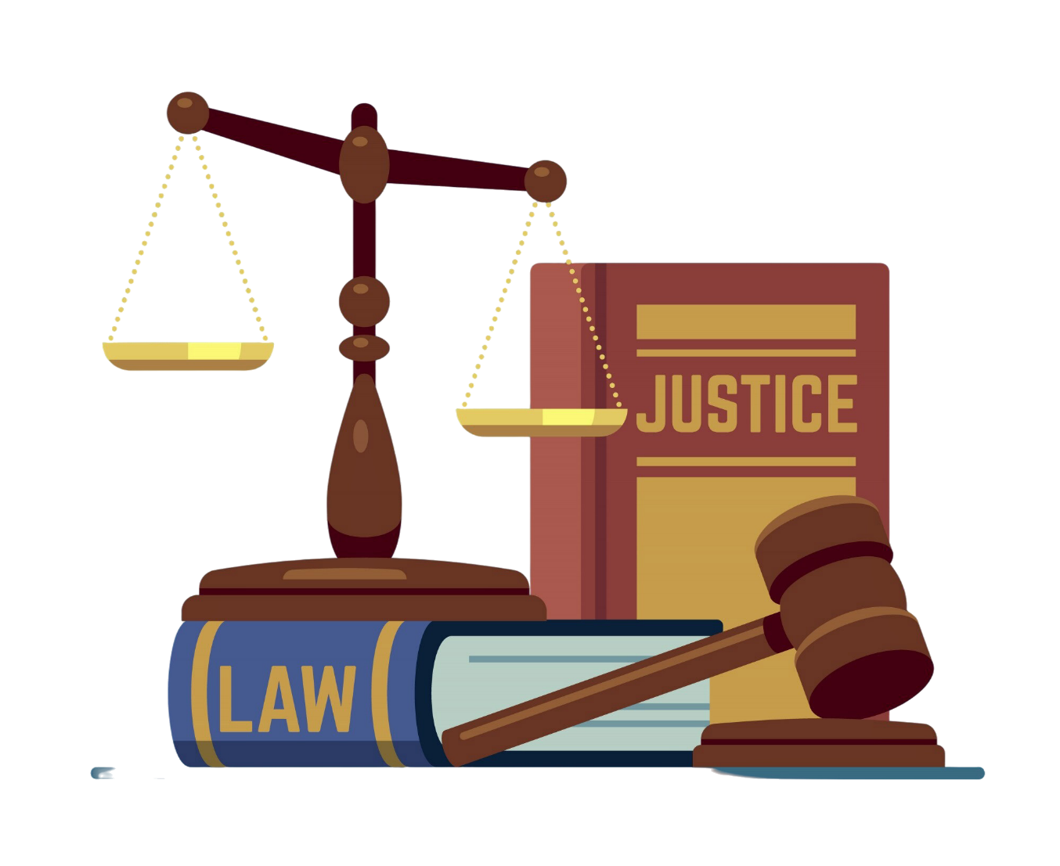
O F F I C E O F T H E D I R E C T O R O F P U B L I C P R O S E C U T I O N S ( O D P P )
Highlights of the Presentation
What are Court Users Committees?
Establishment of CUC’s
Categories of CUC’s
Why were they formed?
The role of CUC’s in strengthening electoral integrity
Role of CUCs in election preparedness and election matteers
Challenges experienced by CUC’s in handling electoral matters
Moving Forward

Slide 3

What are Court Users Committees?
O F F I C E O F T H E D I R E C T O R O F P U B L I C P R O S E C U T I O N S ( O D P P )
The Court Users Committee is a platform for actors in the criminal Justice Sector to discuss and coordinate the functions of the actors involved in the dispensation of justice. The primary mandate of the CUC is to ensure efficient administration of justice within the court and its jurisdiction.
The platform is comprised of both state and non state actors in the justice sector that are thematic. This means that different courts within a jurisdiction will have different Court Users Committees. They are in the High Courts and in the Magistrates Courts.
For example, in the High Court, the different divisions will have their own CUC’s: criminal, civil, anti corruption, land and environment, labour and employment).
In the Magistrates Courts, the CUC’s are organized according to the jurisdiction of the court: criminal, civil, anti corruption, children’s, Anti Terrorism, Small Claims and Khadhi’s court.
The CUC’s are primarily at the level where a court is stationed.
This ensures that the unique and technical aspects that the specialized court are handled comprehensively and by the most relevant actors.

Slide 4
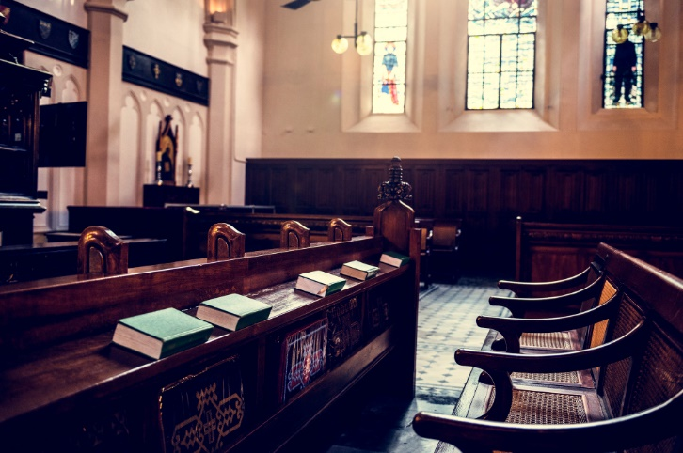
How are CUC’s established?
O F F I C E O F T H E D I R E C T O R O F P U B L I C P R O S E C U T I O N S ( O D P P )
CUC’s are a grassroot level representation of the National Council on Administration of Justice (NCAJ).
The National Council on the Administration of Justice (NCAJ) is established under Section 34 of the Judicial Service Act.
It is a high-level policymaking, implementation and oversight body composed of State and Non-State Actors from the justice sector.
The mandate as stipulated in the Act is to ensure a coordinated, efficient, effective and consultative approach in the administration of justice and reform of the justice system.
The membership of the CUC’s is a reflection of the NCAJ Membership.
Thus, the CUC’s establishment and mandate is pursuant to legislation. Individual Court Users Committees report to the NCAJ, which also exercises oversight for the CUC.

Slide 5
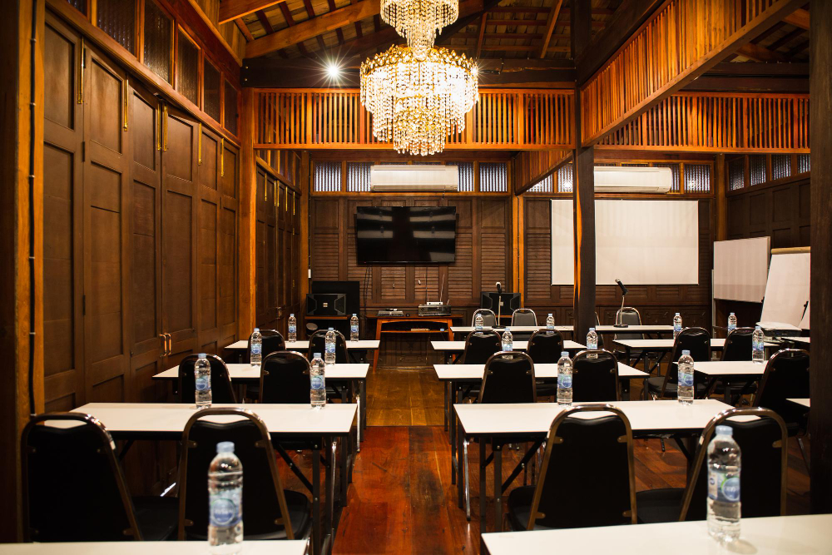
Membership of the Court Users Committees
O F F I C E O F T H E D I R E C T O R O F P U B L I C P R O S E C U T I O N S ( O D P P )
The membership of the CUC reflects that of the NCAJ. However, a CUC is at liberty to co-opt members on an ad hoc or permanent basis according to its needs and relevance to the purpose.
While the membership of CUCs is highly variegated, certain institutions are constant. These include:
Judiciary ;
Office of the Director of Public Prosecutions ;
National Police Service ;
Probation and Aftercare Services ;
Prisons Services ;
Law Society of Kenya ;
Provincial Administration (National Government Administration Officers – these are chiefs, county commissioners) ;
Kenya National Commission on Human Rights;
Children’s Officers ;

Slide 6

Categories of CUC’s
O F F I C E O F T H E D I R E C T O R O F P U B L I C P R O S E C U T I O N S ( O D P P )
Court Users Committees at High Court
Employment and Labour Justice CUCs
Environment and Land Justice CUCs
Court Users Committees at Magistrates’ Court
Children CUCs
Commercial Justice CUCs
Court Users Committees at Kadhis Court
Court Users Committees at Tribunals
Every CUC falls under either of these categories.
Where special magistrates are appointed for a period to hear specific matters, ad hoc CUC’s may be established for that particular purpose.
A CUC may co opt members on an ad hoc basis depending on the prevailing need.

Slide 7
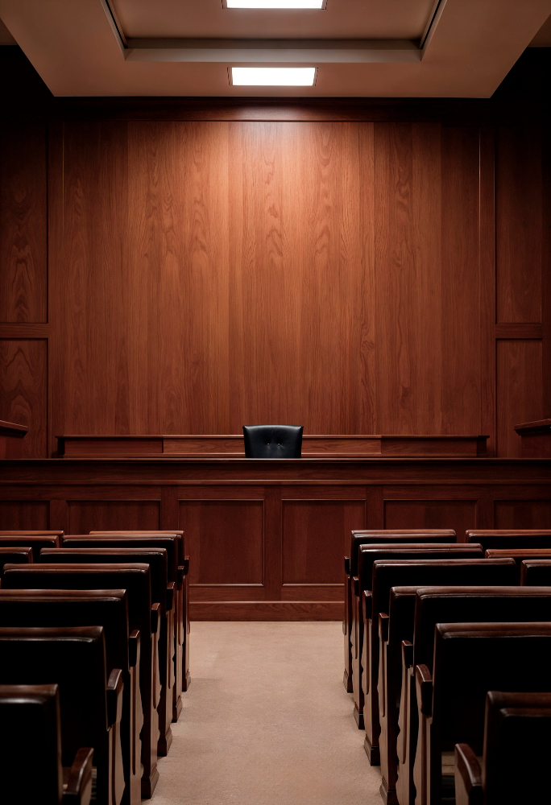
Ctd.
O F F I C E O F T H E D I R E C T O R O F P U B L I C P R O S E C U T I O N S ( O D P P )
For election related matters, special magistrates are appointed to hear and determine matters.
While there is no category of CUC to specifically address election matters, the particular CUC relies on directives issued by the Judiciary Committee on Elections and by other relevant agencies to address emerging issues.
Legal, policy or implementation matters that cannot be addressed at the CUC level are escalated to the NCAJ

Slide 8

Why were CUC’s formed?
O F F I C E O F T H E D I R E C T O R O F P U B L I C P R O S E C U T I O N S ( O D P P )
The realization that the justice system is chain-linked in the service of the people, and that the silo approaches by actors in the justice sector did not enhance access to justice, the Court Users Committees were formed to enhance synergy in the dispensation of justice.
That the mandate, potential and capacity of very actor in the justice sector is connected and interdependent, necessitated actors to come together to collaborate towards the common intention of delivering justice for the people.
Through effective partnerships, stakeholder engagements, coordination and holding each other accountable, the overall effect is proper application of the rule of law, democracy and human rights of the people under the jurisdiction of the Court Users Committee.

Slide 9
Functions of the CUC in Strengthening Electoral Integrity
O F F I C E O F T H E D I R E C T O R O F P U B L I C P R O S E C U T I O N S ( O D P P )
To ensure an accountable, coordinated, efficient, effective and consultative approach in the delivery of justice. Election matters have a legally stipulated timeline within which cases must be heard and determined. Therefore, coordination among actors is paramount to expedite matters.
Implement policies and strategies of the NCAJ .
Identify needs and challenges from various agencies, that hinder the expeditious delivery of justice and propose effective solutions;
To improve access to electoral justice through the CUC agencies
To ensure the quality in service delivery by all actors in the justice system reflects the Rule of Law and principles of democracy
To enhance public participation and engagement on matters touching on democracy and election offices affecting the community.
To strengthen feedback mechanisms and promote dialogue among stakeholders and court users.
To propose policies for implementation by the NCAJ to address specific issues for effective delivery of justice

Slide 10

What are the Roles/Objectives of CUCs in CUCs in election preparedness and election justice?
O F F I C E O F T H E D I R E C T O R O F P U B L I C P R O S E C U T I O N S ( O D P P )
The CUCs have a two-tier approach in addressing matters, first, amongst the membership of the CUC as partner agencies, and secondly, as a unified body to members of the community and public.
With regard to the members of the CUC, the roles include:
Conduct capacity building and training of members in preparation for the electioneering period.
Discuss and promote crime prevention initiatives among stakeholders.
Adopt an inter agency approach to issues of the jurisdiction. For instance, some areas may have prevalence in voter bribery, violence, hate speech or technology facilitated electoral violence.

Slide 11
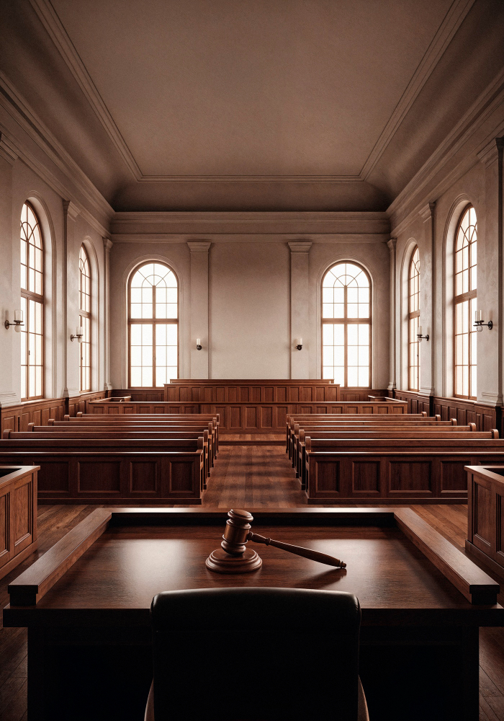
Ctd….
O F F I C E O F T H E D I R E C T O R O F P U B L I C P R O S E C U T I O N S ( O D P P )
Promote information sharing and learning among stakeholders
Ensure and hold members accountable in the performance of their duties as actors in the justice chain. This is through Integrity Committees for the court station. The CUC handles matters of delays by agencies, undue influence, prejudice and affiliations which may affect the dispensation of electoral justice.
Cultivate partnerships and improve inter agency relations amongst stakeholders.
Discuss and address complaints from members of the public on the mandate of any of the agencies
Adopt resolutions for the expedient handling of matters

Slide 12





Duties of the CUC towards the Public
O F F I C E O F T H E D I R E C T O R O F P U B L I C P R O S E C U T I O N S ( O D P P )
Conduct public sensitization and civic education on election laws, malpractice, offences and penalties.
Engage in community dialogue and open days to interact with the public.
Addressing complaints from other stakeholders and members of the public.
Address concerns from the public on election related matters and democratic rights.
Promote Alternative Dispute Resolution and alternatives to prosecution in suitable matters

Slide 13
How do CUC’s operate to strengthen electoral integrity?
O F F I C E O F T H E D I R E C T O R O F P U B L I C P R O S E C U T I O N S ( O D P P )
They are required to meet every quarter, address emerging issues and implement their work plans.
1
In an election year, the Work Plans involve sensitizations, open days, community dialogues and implementation of agreed parameters on handling election related offences.
2
The court, together with the actors in the justice sector can agree on strategic direction on how to handle pertinent issues that affects their community during, before and after the elections period.
3
For example, there are regions which are adversely affected by voter bribery or become hot spots for violence as a result of hate speech.
Through the CUC, the action every actor should take to curb the vice is agreed upon. For instance, they can make resolutions on:
4

Slide 14
O F F I C E O F T H E D I R E C T O R O F P U B L I C P R O S E C U T I O N S ( O D P P )
How to handle bail applications for offenders
To give strict penalties and fines for offenders
To conduct a public sensitization on the issue to members of the community
Inter agency collaboration with the local administration in monitoring, arresting offenders and collection and preservation of evidence and so on.
NB: In deliberating and adopting solutions, they must be legally enforceable and cannot be ultra vires the Constitution, Human Rights or the Rule of Law.
Legal, policy and administrative matters that the CUCs cannot handle are escalated to the NCAJ for deliberation and directions.
The Council decisions then trickle back to the CUCs or the specific justice institutions for action.

Slide 15
Challenges experienced by CUC’s in electoral integrity
O F F I C E O F T H E D I R E C T O R O F P U B L I C P R O S E C U T I O N S ( O D P P )
Case backlog – This affects the running of the courts and availability of parties to attend CUC meetings.
Negative public perception of the justice system
Attitudes and perceptions from actors that hinder effective and efficient working of the CUC
Failure of actors to attend meetings and commit to the resolutions
Lack of proper coordination and communication in the justice sector
Unavailability of expert witnesses

Slide 16
Conclusion
O F F I C E O F T H E D I R E C T O R O F P U B L I C P R O S E C U T I O N S ( O D P P )
The elections period is a sensitive time, which calls for inter agency and stakeholder collaboration, which can be achieved through the Court Users Committees.
The Committees have strengthened stakeholder relationships, improved trust among agencies and enhanced accountability and transparency in the criminal justice sector reforms.
Despite the challenges, Court Users Committee’s have proved invaluable to the justice sector. The gains outweigh the challenges.

Slide 17


THANK YOU

