Slide 1
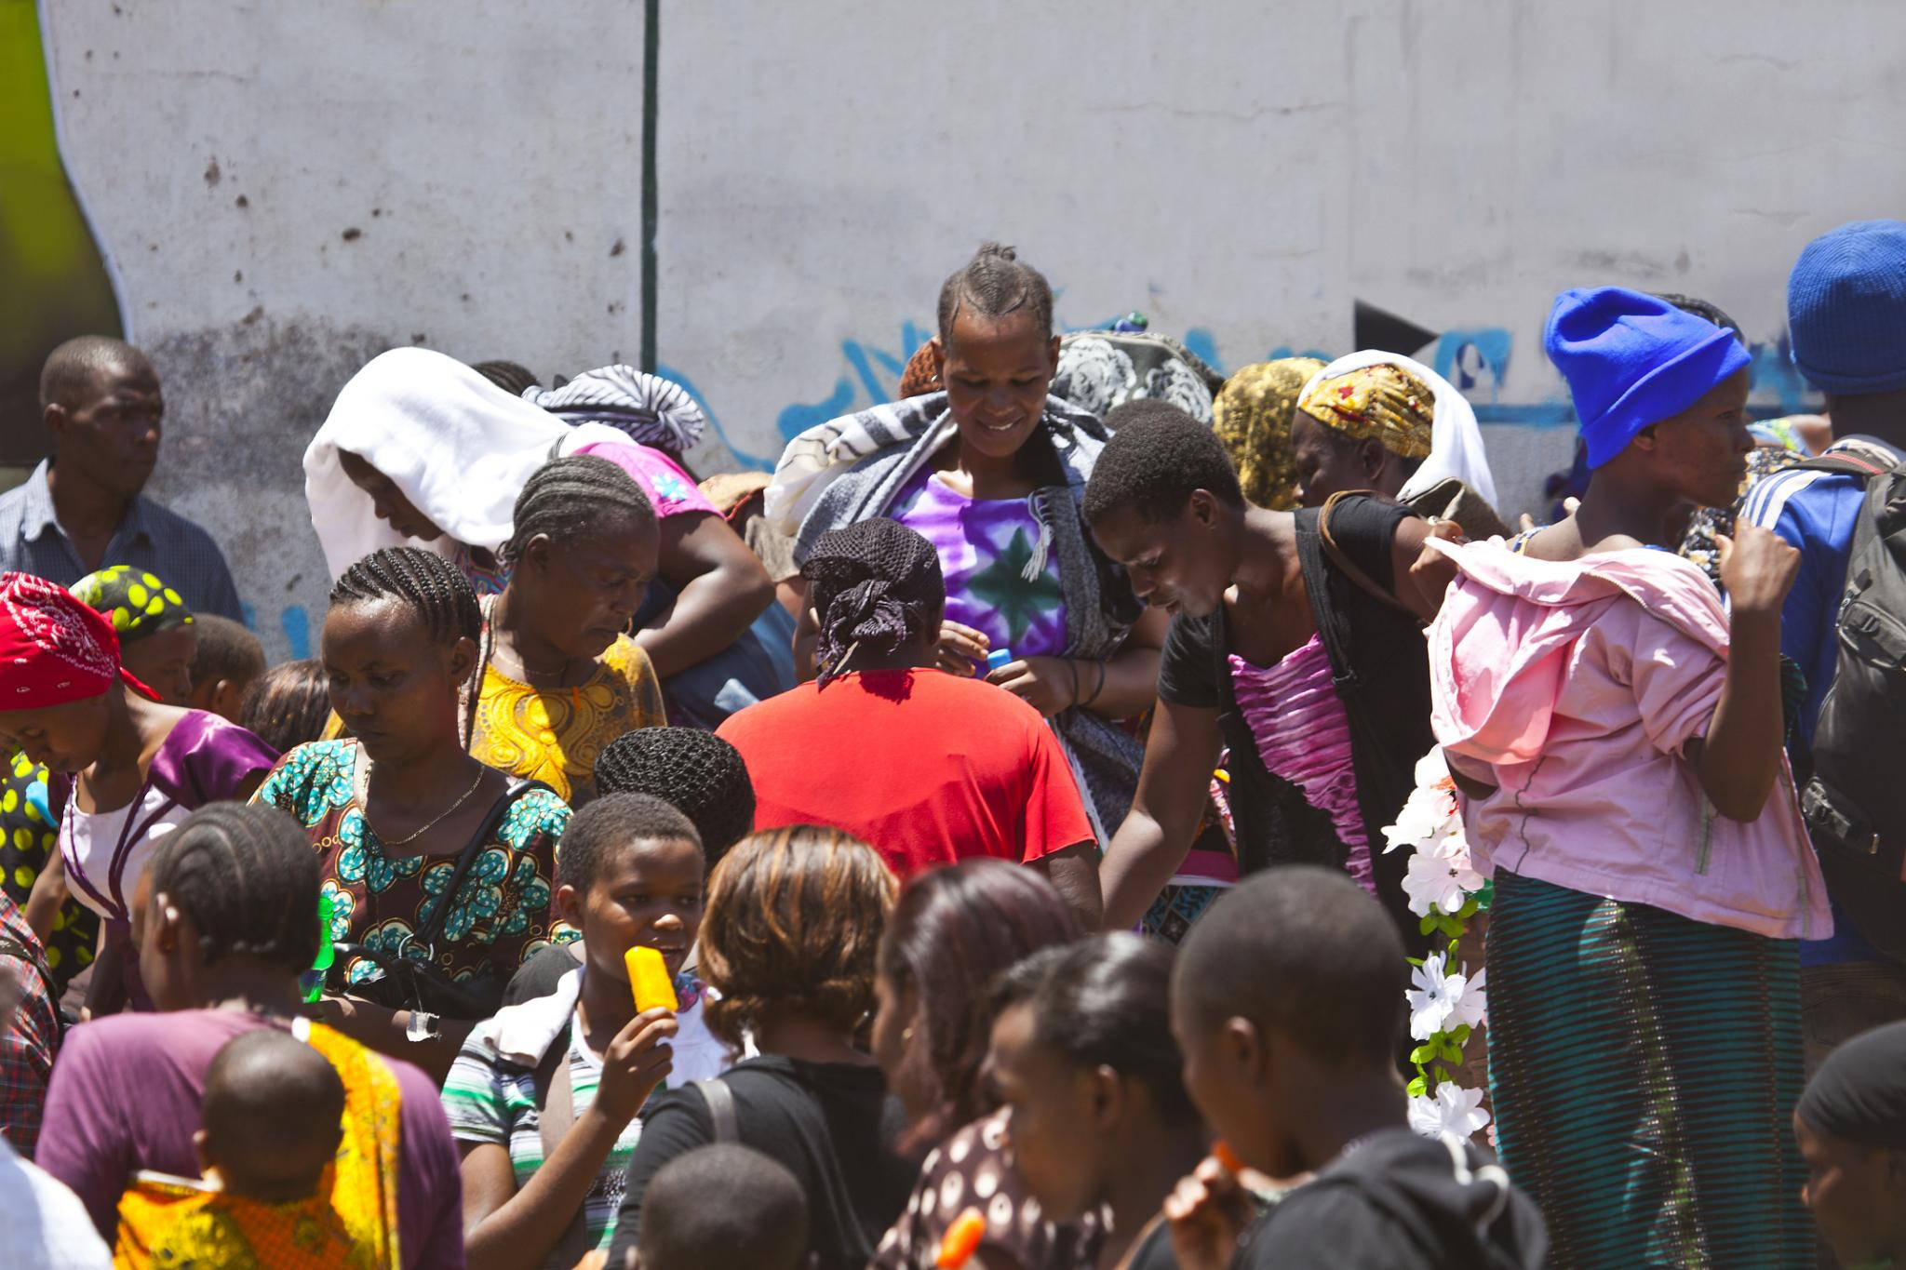

4TH NATIONAL PROSECUTION AUTHORITY CONFERENCE
IDENTIFYING AND COMBATING HUMAN TRAFFICKING RISKS DURING ELECTIONS
By Dorah Caroline Mafabi- Director JTIP- Save the Children International
Notes:
Image source: Microsoft 365 content library

Slide 2
Poll:
How many have read the Anti-Human Trafficking Act?
How many have used/applied the Anti-Human Trafficking Act?
How many have secured convictions on human trafficking cases?
How many have been trained on human trafficking in the last 2-4 years?
How many can draw a nexus between human trafficking and elections?
How many were curious when you saw the topic on the agenda?’

Slide 3
Introduction: Human Trafficking and Elections
Trafficking in persons is one of the most pervasive forms of organised crime that weakens governance systems and threatens democratic processes.
Political transitions and election periods often increase trafficking risks due to:
– Increased population movement
– Weak institutional oversight
– Economic vulnerability
– Informal labour demand and political mobilisation

Slide 4
CONTINUE…
Section 2(c) of the Anti-Human Trafficking Act No. 16 of 2022 defines trafficking in persons as:
The recruitment, transportation, transfer, harbouring or receipt of persons through coercion, deception or abuse of vulnerability for the purpose of exploitation.
Exploitation includes forced labour, sexual exploitation, domestic servitude, child labour, forced marriage, removal of body parts, and other forms of modern slavery.

Slide 5
Introduction: Human Trafficking and Elections Cont”
Elements of Trafficking
Act – recruitment, transportation, transfer, harbouring or receipt of a person (movement not required).
Means – coercion, deception, abduction, abuse of power or vulnerability, or fraud.
Purpose – exploitation.
Important Note
In child trafficking cases, the means element is not required. Any recruitment or movement of a child for exploitation constitutes trafficking.

Slide 6
Facts and Figures on Human Trafficking
Key Global Trends
$528.5 billion – estimated global profits from human trafficking (Global Financial Crime Report, 2026).
This is significantly higher than the combined GDP of Zambia, Zimbabwe, Mozambique, Botswana and Malawi ($132 billion in 2024).
Since 2023, funds linked to trafficking have grown by 23.5%, driven by:
– Emerging forms of exploitation
– Use of AI and digital technologies to recruit and deceive victims
– High financial returns for criminal networks

Slide 7
Facts and Figures on Human Trafficking CONT”
The International Labour Organization (ILO, 2022) estimates 50 million people are living in modern slavery.
Victim Profile (UNODC, 2024)
Women and girls: over 70% of detected trafficking victims.
Sexual exploitation: over 90% are women and girls.
Children: more than 50% of victims globally.

Slide 8
Facts and Figures on Human Trafficking CONT”
The International Labour Organization (ILO, 2022) estimates 50 million people are living in modern slavery.
Victim Profile (UNODC, 2024)
Women and girls: over 70% of detected trafficking victims.
Sexual exploitation: over 90% are women and girls.
Children: more than 50% of victims globally.

Slide 9


Human Trafficking: Election-Period Risks
Why elections elevate risk
Heightened movement, economic pressure, and shifting security priorities reduce detection, enabling traffickers during political transitions.
Legal framing: Human Trafficking Act No. 16 of 2022
Defines act, means, and purpose; no cross-border movement required; child trafficking does not require coercion.
Trends and prosecutorial imperatives
Rise of digital recruitment and complex networks demands vigilant detection, prevention, and consistent prosecution to safeguard dignity.
Scale and urgency
Global findings (ILO, UNODC) show millions in modern slavery—women and girls disproportionately affected.
Notes:
Human trafficking constitutes one of the most pervasive forms of organized crime globally, weakening governance structures and threatening democratic institutions, particularly during periods of political transition such as election cycles. During elections, heightened population movement, increased economic pressures, and shifts in national security priorities create conditions in which traffickers can operate with reduced risk of detection. The Anti-Human Trafficking Act No. 16 of 2022 outlines the key components of trafficking by defining the act, means, and purpose required to establish an offence—highlighting that trafficking does not require cross-border movement and that child trafficking does not require the element of coercion. The exploitation that results, including forced labour, sexual exploitation, domestic servitude, and forced criminality, underscores the profound human rights violations inherent in this crime. In this context, prosecutors must pay close attention to evolving trafficking trends, particularly the rise of digital recruitment and sophisticated exploitation networks, which are increasingly observed worldwide. Global reports, including findings from the International Labour Organization and the UN Office on Drugs and Crime, emphasize that millions remain trapped in modern slavery, with women and girls disproportionately represented among victims. These realities highlight the urgency for legal practitioners, policy makers, and justice-sector actors to understand both the structural and situational conditions that elevate trafficking risks during political events. By recognizing and interrogating these vulnerabilities, especially those triggered by electoral cycles, justice institutions can better prepare to detect, prevent, and prosecute trafficking cases with the vigilance and consistency required to safeguard human dignity and uphold the rule of law.
Image source: Microsoft 365 content library

Slide 10
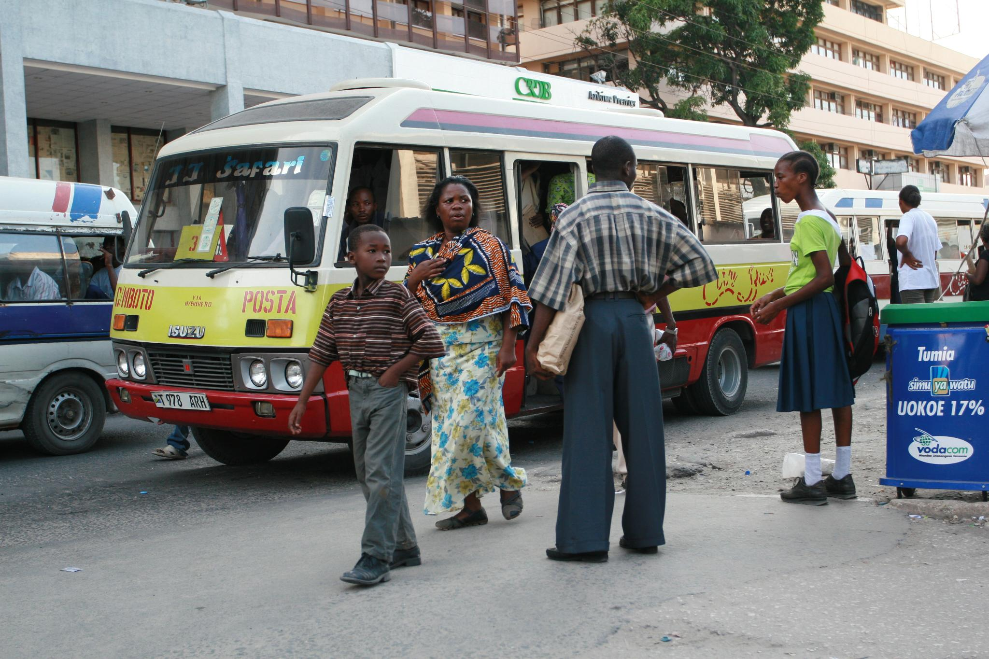
Global and Regional Trends
Scale and Economics
Traffickers generate $528.5B+ globally; modern slavery affects ~50M people.
Gendered Impact
Women and girls are 70%+ of detected victims; 90%+ in sexual exploitation.
Digital and Socioeconomic Drivers
Inequality and online manipulation fuel adaptive, tech‑enabled trafficking networks.
Enforcement Gap and Response
Low prosecutions—incl. Zambia—demand financial tracking, tech expertise, and multi‑sector collaboration.
Notes:
Human trafficking has escalated into one of the most profitable illicit enterprises, with recent reports estimating that traffickers generate more than $528.5 billion worldwide from the exploitation of vulnerable individuals. This staggering figure surpasses the economic output of several Southern African economies combined, illustrating the scale and financial power of trafficking syndicates. Globally, modern slavery affects an estimated 50 million people, according to the International Labour Organization, with human trafficking being a significant subset of this humanitarian crisis. Women and girls comprise more than 70 percent of detected trafficking victims, and over 90 percent of those trafficked for sexual exploitation, indicating that gender remains a central factor in vulnerability and victimization. These figures further suggest that socioeconomic disparities, gender inequality, and digital manipulation continue to fuel exploitation, with traffickers increasingly adapting to emerging technologies and economic vulnerabilities. Regionally, prosecution rates remain alarmingly low, illustrating persistent challenges in evidence collection, cross‑border cooperation, and institutional readiness. In Zambia in particular, while double‑digit prosecution numbers exist, they remain far below what would be expected given the scale of trafficking activities recorded through social services, law enforcement, and border‑point reports. This mismatch reflects a broader global challenge in curbing trafficking operations effectively and underscores the need for prosecutors to integrate financial tracking, technological expertise, and multi‑sectoral collaboration into case development. As trafficking becomes more digitally enabled and economically entrenched, a sophisticated, coordinated response is required to dismantle networks and protect vulnerable communities—particularly during politically sensitive periods such as elections.
Image source: Microsoft 365 content library

Slide 11
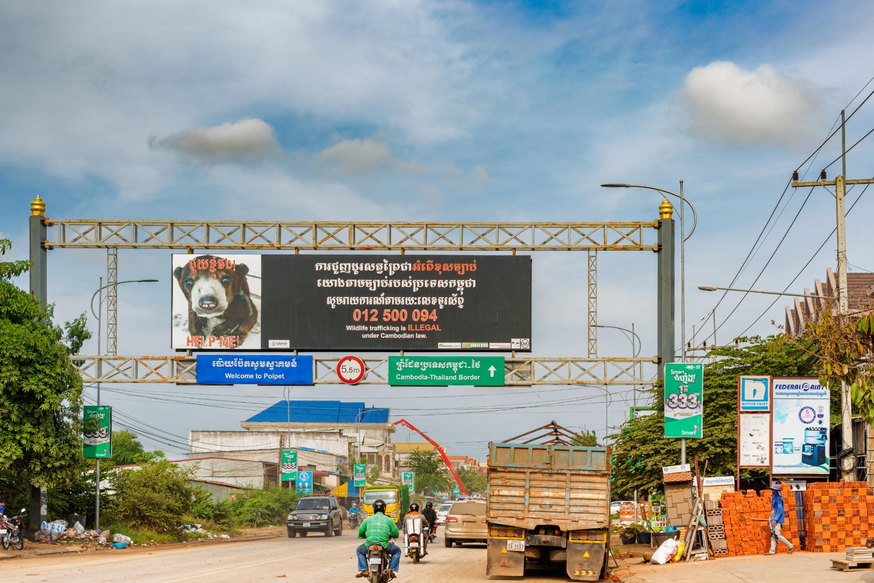
Human Trafficking in Zambia
Scope and Sectors
Zambia is a source, transit, and destination. Victims are exploited in agriculture, construction, mining, domestic work, and informal labour.
High‑Risk Corridors
Nakonde, Chirundu, Kasumbalesa, and Kazungula see elevated risk due to porous borders and regional migration patterns.
Legal Distinction
Nyasa Nicole Mulumbilwa affirms: trafficking requires exploitation; migrant smuggling does not—key for charging decisions.
Enforcement & Priorities
Despite strong laws (2008 Act, amended 2022), cases like Wina Lubinda show the need for precise, evidence‑based, coordinated prosecution—especially ahead of elections.
Notes:
Zambia functions simultaneously as a source, transit, and destination country for victims of human trafficking, a reality documented in international assessments such as the U.S. State Department Trafficking in Persons (TIP) Report. Trafficking victims in Zambia are often exploited in sectors including agriculture, construction, mining, domestic work, and informal labour settings. Border areas such as Nakonde, Chirundu, Kasumbalesa, and Kazungula serve as high‑risk corridors due to porous borders and patterns of regional migration. A critical distinction emphasized in Zambian jurisprudence—highlighted in the Court of Appeal case *Nyasa Nicole Mulumbilwa & Others v The People*—is the legal difference between migrant smuggling and human trafficking, with exploitation being the defining component of trafficking. This distinction is essential for prosecutors because cases often involve overlapping circumstances. Enforcement challenges persist despite strong legislative frameworks such as the Anti‑Human Trafficking Act No. 11 of 2008 (as amended in 2022), which carries penalties ranging from lengthy imprisonment to life sentences. However, cases such as *Wina Lubinda v The People* illustrate the need for precise evidence‑gathering and rigorous courtroom presentation, as courts require that all elements of trafficking be proven beyond reasonable doubt. These inconsistencies in enforcement, combined with socioeconomic vulnerabilities, cross‑border migration, and evolving digital recruitment methods, highlight systemic gaps in detection and prosecution. As Zambia approaches national elections, these gaps may widen, making it essential for prosecutors, investigators, and allied professionals to strengthen coordination, pursue evidence‑based approaches, and leverage specialized expertise to ensure effective prosecution and victim protection.
Image source: Microsoft 365 content library

Slide 12
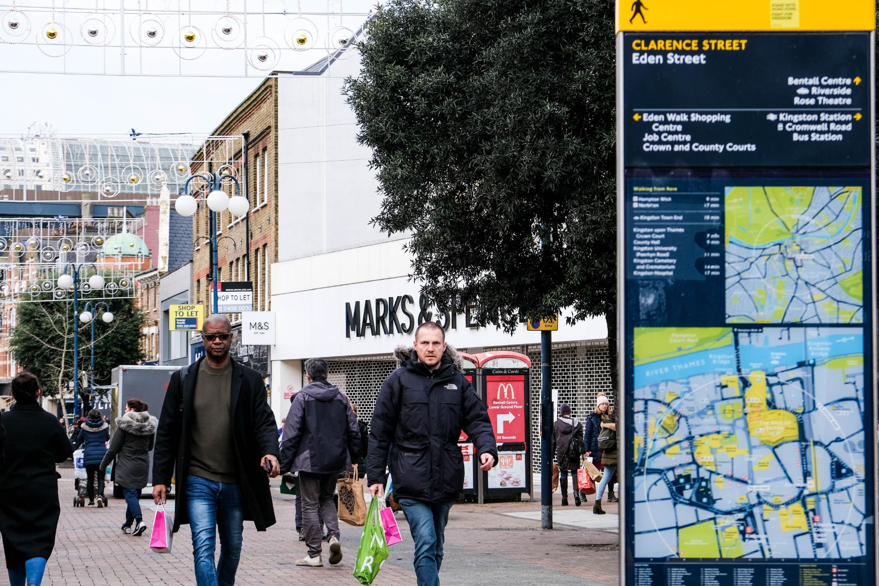
Why Elections Increase Risk
Diverted Oversight
Security focus shifts to polls, reducing anti‑trafficking enforcement and monitoring capacity.
Mobility & Migration Spikes
Campaign travel and displacement expand recruiter reach and blur oversight across routes.
Digital Lures & Youth Mobilization
Fake jobs, scholarships, and campaign work target youth online, enabling coercion and abuse.
Profit Laundering into Politics
Criminal networks channel proceeds into campaigns, undermining institutions and oversight.
Notes:
Election periods inherently heighten human trafficking risks due to shifts in national priorities, increased mobility, and weakened institutional oversight. As state actors divert attention and resources toward election security, law enforcement and investigative capacity in other sectors—including anti‑trafficking operations—often decline, providing traffickers with a window of opportunity. These vulnerabilities are compounded by increased migration during campaign seasons, rising online engagement, and greater economic desperation among youth and marginalized communities, making them susceptible to recruitment through fraudulent job offers or coercive political activities. Criminal networks may also exploit the election environment to channel trafficking profits into political financing, thereby influencing political processes and compromising institutional integrity. Research by organizations such as International IDEA and ACCORD indicates that trafficking networks expand operations during elections, often going deeper underground due to weakened monitoring systems. Traffickers also use digital platforms more aggressively during election periods to lure victims through fake employment advertisements, false scholarships, or political mobilisation schemes disguised as legitimate opportunities. Youth mobilization, a common feature of election campaigning, becomes an entry point for exploitation when young people are recruited for labour without legal protections, exposing them to abuse, forced labour, or debt bondage. Furthermore, traffickers may target communities experiencing political tensions, especially those vulnerable to displacement, economic instability, or reduced community oversight. These dynamics collectively create a fertile environment for exploitation, necessitating heightened vigilance from prosecutors, investigators, election observers, and civil society organizations to ensure early detection, swift response, and sustained protection efforts.
Image source: Microsoft 365 content library

Slide 13
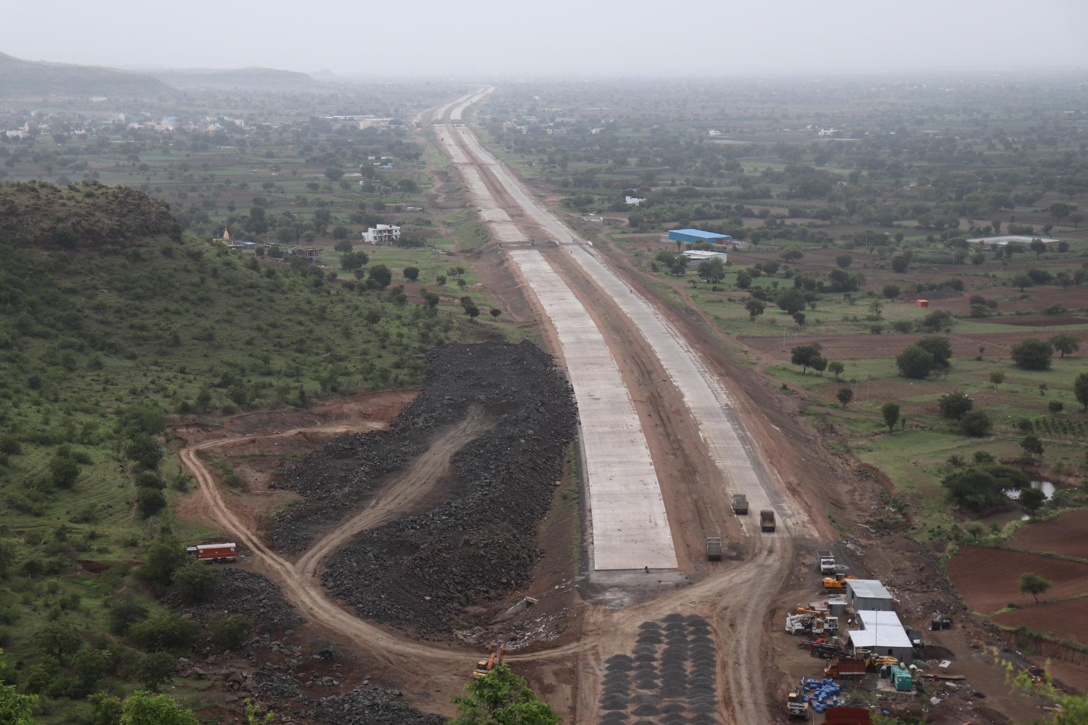
Election‑Related Trafficking Risks
Crowds, Travel, and Rallies
Large gatherings and regional movement create cover to recruit, transport, or exploit under political pretexts.
Youth Mobilization & Informal Labor
Unemployed or vulnerable youth are recruited without contracts, facing coercive work and exploitation.
Reduced Oversight During Elections
Security focus shifts to electoral events, lowering monitoring at borders, in communities, and online.
Criminal Financing & Influence
Trafficking proceeds may fund campaigns, enabling influence over officials and shielding from prosecution.
Misinformation Intensifies Risks
Digital falsehoods heighten tensions and obscure indicators, requiring risk‑based monitoring and alerts.
Notes:
Election‑related risk factors for trafficking include increased population movement, youth mobilization for political activities, reduced institutional oversight, and the potential infiltration of political financing systems by organized criminal networks. Large crowds, political rallies, and regional travel create opportunities for traffickers to recruit, transport, or exploit victims under the guise of political engagement or temporary employment. Young people—particularly those who are unemployed or economically vulnerable—are frequently recruited to support campaign activities without formal contracts, exposing them to coercive labour, long working hours, and exploitative conditions. Additionally, security agencies shift focus toward electoral security, which may reduce monitoring of trafficking indicators at borders, within communities, and online. Criminal organizations may also use trafficking proceeds to fund political campaigns, allowing them to gain influence over future public officials and secure protection from prosecution. These risks become more pronounced when political tensions rise or when misinformation and disinformation spread through digital platforms. Recognizing the intersection between political processes and trafficking risks is crucial for developing risk‑based monitoring, targeted interventions, and early warning systems that can be used by prosecutors, electoral bodies, and civil society organizations to strengthen prevention and accountability during elections.
Image source: Microsoft 365 content library

Slide 14
Prosecution Strategies During Elections
1. Speedy Handling of Cases
Ensure quick disposition of existing cases and early handling of new cases during elections.
Encourage prosecution-guided investigations with law enforcement.
Close cooperation between prosecutors and investigators is critical because trafficking cases are complex and evidence-intensive.
2. Strong Case Preparation
Ensure sufficient evidence to prove all elements of trafficking.
Engage specialised experts, including:
– Digital evidence experts (given evolving online exploitation and AI).
– Financial experts to trace and follow illicit money flows.
Notes:
Effective prosecution of human trafficking during election periods requires strategic planning, inter‑agency cooperation, and an unwavering commitment to victim‑centred practices. Prosecutors must prioritize rapid case handling to reduce opportunities for interference, protect victims, and maintain public trust in the justice system—especially when victims include foreign nationals or individuals kept in shelters for extended periods. Strong collaboration with investigators is crucial, particularly in gathering digital evidence, tracing financial flows, and understanding evolving trafficking techniques. Prosecutors should proactively work with experts such as financial analysts, cybercrime specialists, and forensic professionals to strengthen case foundations. A victim‑centred approach is essential and includes measures such as using pseudonyms, securing safe spaces for testimony, limiting unnecessary adjournments, and requesting that courts restrict media access where appropriate. Given the increasing complexity of trafficking cases during politically sensitive periods, prosecutors must remain vigilant about safeguarding child victims, supporting migrant communities, and ensuring that frontline officers are adequately trained to identify trafficking indicators. A key strategy involves following the money—tracking illicit financial flows to dismantle criminal networks and pursuing asset forfeiture to undermine the profitability of trafficking operations. Partnerships with specialized institutions such as the Anti‑Human Trafficking Department enhance expertise, facilitate coordinated investigations, and contribute to the development of jurisprudence that strengthens national responses to trafficking.
Image source: Microsoft 365 content library

Slide 15
Prosecution Strategies During Elections
3. Victim-Centred Approach
Protect victims and witnesses throughout proceedings.
Special protections for children, including camera proceedings.
Use pseudonyms instead of victim names where appropriate.
Request courts to restrict media access and provide safe spaces for victims.
Key Consideration
Delays increase risks of interference with victims, witnesses and the justice process.
Speedy prosecution strengthens public confidence in the justice system.
Notes:
Effective prosecution of human trafficking during election periods requires strategic planning, inter‑agency cooperation, and an unwavering commitment to victim‑centred practices. Prosecutors must prioritize rapid case handling to reduce opportunities for interference, protect victims, and maintain public trust in the justice system—especially when victims include foreign nationals or individuals kept in shelters for extended periods. Strong collaboration with investigators is crucial, particularly in gathering digital evidence, tracing financial flows, and understanding evolving trafficking techniques. Prosecutors should proactively work with experts such as financial analysts, cybercrime specialists, and forensic professionals to strengthen case foundations. A victim‑centred approach is essential and includes measures such as using pseudonyms, securing safe spaces for testimony, limiting unnecessary adjournments, and requesting that courts restrict media access where appropriate. Given the increasing complexity of trafficking cases during politically sensitive periods, prosecutors must remain vigilant about safeguarding child victims, supporting migrant communities, and ensuring that frontline officers are adequately trained to identify trafficking indicators. A key strategy involves following the money—tracking illicit financial flows to dismantle criminal networks and pursuing asset forfeiture to undermine the profitability of trafficking operations. Partnerships with specialized institutions such as the Anti‑Human Trafficking Department enhance expertise, facilitate coordinated investigations, and contribute to the development of jurisprudence that strengthens national responses to trafficking.
Image source: Microsoft 365 content library

Slide 16
Prosecution Strategies During Elections cont”
4. Follow the Money
Trafficking is profit-driven organised crime.
Investigations should trace financial flows and dismantle trafficking networks.
Seek asset forfeiture where profits are derived from trafficking.
5. Build Capacity
Improve understanding of the Anti-Human Trafficking Act.
Recognise that consent is not a defence where coercion or deception exists
(S v Sayed and Others, 2018).
Expand training for police, immigration, and customs officers, particularly in trafficking hotspots.
Notes:
Effective prosecution of human trafficking during election periods requires strategic planning, inter‑agency cooperation, and an unwavering commitment to victim‑centred practices. Prosecutors must prioritize rapid case handling to reduce opportunities for interference, protect victims, and maintain public trust in the justice system—especially when victims include foreign nationals or individuals kept in shelters for extended periods. Strong collaboration with investigators is crucial, particularly in gathering digital evidence, tracing financial flows, and understanding evolving trafficking techniques. Prosecutors should proactively work with experts such as financial analysts, cybercrime specialists, and forensic professionals to strengthen case foundations. A victim‑centred approach is essential and includes measures such as using pseudonyms, securing safe spaces for testimony, limiting unnecessary adjournments, and requesting that courts restrict media access where appropriate. Given the increasing complexity of trafficking cases during politically sensitive periods, prosecutors must remain vigilant about safeguarding child victims, supporting migrant communities, and ensuring that frontline officers are adequately trained to identify trafficking indicators. A key strategy involves following the money—tracking illicit financial flows to dismantle criminal networks and pursuing asset forfeiture to undermine the profitability of trafficking operations. Partnerships with specialized institutions such as the Anti‑Human Trafficking Department enhance expertise, facilitate coordinated investigations, and contribute to the development of jurisprudence that strengthens national responses to trafficking.
Image source: Microsoft 365 content library

Slide 17
Prosecution Strategies During Elections cont”
6 Strengthen Institutional Partnerships
Strengthen collaboration between NPA and the Anti-Human Trafficking Department (AHTD)
Enhance coordination with law enforcement and anti-corruption institutions.
Multi-Agency Strategic Actions
DPP: Issue prosecutorial alerts on election-period trafficking risks.
Regional cooperation: Work with neighbouring states on cross-border trafficking.
Electoral Commission: Integrate trafficking indicators into election observation.
Law enforcement: Include trafficking risks in electoral security plans.
Goal
A coordinated, multi-sectoral response to detect, investigate and prosecute trafficking during elections.
Notes:
Effective prosecution of human trafficking during election periods requires strategic planning, inter‑agency cooperation, and an unwavering commitment to victim‑centred practices. Prosecutors must prioritize rapid case handling to reduce opportunities for interference, protect victims, and maintain public trust in the justice system—especially when victims include foreign nationals or individuals kept in shelters for extended periods. Strong collaboration with investigators is crucial, particularly in gathering digital evidence, tracing financial flows, and understanding evolving trafficking techniques. Prosecutors should proactively work with experts such as financial analysts, cybercrime specialists, and forensic professionals to strengthen case foundations. A victim‑centred approach is essential and includes measures such as using pseudonyms, securing safe spaces for testimony, limiting unnecessary adjournments, and requesting that courts restrict media access where appropriate. Given the increasing complexity of trafficking cases during politically sensitive periods, prosecutors must remain vigilant about safeguarding child victims, supporting migrant communities, and ensuring that frontline officers are adequately trained to identify trafficking indicators. A key strategy involves following the money—tracking illicit financial flows to dismantle criminal networks and pursuing asset forfeiture to undermine the profitability of trafficking operations. Partnerships with specialized institutions such as the Anti‑Human Trafficking Department enhance expertise, facilitate coordinated investigations, and contribute to the development of jurisprudence that strengthens national responses to trafficking.
Image source: Microsoft 365 content library

Slide 18

Regional Lessons: Election-Time Anti‑Trafficking
Kenya: Integrated Risk Indicators
Election security assessments include organized crime and trafficking signals, improving intel sharing among regulators, police, and borders.
Philippines: Observer Training
Civil society monitors and observers are trained to spot trafficking indicators during election-related activities.
Cross‑Agency Frameworks
Pre‑planning and shared indicators enable detection of suspicious flows, movements, and recruitment networks.
Zambia: Practical Adoption
Embed trafficking risk in election security to strengthen early detection, coordination, and evidence‑based prevention.
Ugandan Case Insight
A parliamentary aspirant was allegedly trafficked under a false teaching job, exposing links between political influence, financial gain, and abuse of power
Notes:
Countries across Africa and Asia offer valuable lessons in mitigating trafficking risks during politically sensitive periods. Kenya has integrated organized crime and human trafficking indicators into its national election security assessments, enabling improved intelligence sharing among financial regulators, law enforcement agencies, and border control authorities. This approach helps identify suspicious financial flows, monitor cross‑border movement, and detect potential recruitment networks before exploitation occurs. Similarly, the Philippines has woven human trafficking awareness into its election observation systems, ensuring that civil society monitors, election observers, and community organisations are trained to identify trafficking indicators during election‑related activities. These integrated frameworks demonstrate the importance of multi‑agency collaboration, pre‑planning, and incorporating trafficking risks into broader electoral governance and national security strategies. For Zambia, adopting similar approaches could strengthen early detection, inter‑sectoral coordination, and evidence‑based prevention efforts, particularly as the nation approaches future elections and seeks to fortify protections for vulnerable populations.
Image source: Microsoft 365 content library

Slide 19
SCI Response to Trafficking in Persons
Country strategy- one of the core-pillar is child protection
Child Protection- Safe families, Safe communities, Stronger institutions, strong legal and policy protection frameworks
Thematic Issues: Child rights Governance, Trafficking in Persons, Education, Health, Climate Change and Poverty reduction among others
Trafficking in Persons
Partnership to Prevent Trafficking in Persons – US Government and Government of Zambia
Ministry of Home Affairs and Internal Security (Anti- Human Trafficking Department)
4 Pillar Framework ( Prevention, Protection, Prosecution and Partnerships)
  Prevention: National Action Plan on TiP and SoM, National Communication Strategy, Regulations to the Anti-Human Trafficking Act, Community outreach and awareness activities. Etc.
  Protection: Standard Operating Procedures for Tollfree lines, TIF Fund Guidelines, Shelters for VoTs, Case Management System (cross -cutting)
  Prosecution: Desk Guide for Judicial Officers, Standardised TIP Curriculum, Investigations and intelligence gathering, Trainings.
  Partnerships: National Coordination Committee on TiP, Strengthen Civil Society response to TiP, Commemorating International Days e.g. March 8th, July 30th, November 15th, etc
Notes:
Countries across Africa and Asia offer valuable lessons in mitigating trafficking risks during politically sensitive periods. Kenya has integrated organized crime and human trafficking indicators into its national election security assessments, enabling improved intelligence sharing among financial regulators, law enforcement agencies, and border control authorities. This approach helps identify suspicious financial flows, monitor cross‑border movement, and detect potential recruitment networks before exploitation occurs. Similarly, the Philippines has woven human trafficking awareness into its election observation systems, ensuring that civil society monitors, election observers, and community organisations are trained to identify trafficking indicators during election‑related activities. These integrated frameworks demonstrate the importance of multi‑agency collaboration, pre‑planning, and incorporating trafficking risks into broader electoral governance and national security strategies. For Zambia, adopting similar approaches could strengthen early detection, inter‑sectoral coordination, and evidence‑based prevention efforts, particularly as the nation approaches future elections and seeks to fortify protections for vulnerable populations.
Image source: Microsoft 365 content library

Slide 20
Conclusion: Safeguarding Elections from Trafficking
Whole‑of‑Society Response
Trafficking spans social, economic, and political spheres—demanding coordinated action across institutions and communities.
Heightened Risk in Elections
Politically charged periods increase vulnerabilities—calling for vigilance, fairness, and accountability.
Role of Prosecutors
As sentinels of democracy, they must deliver justice without fear or favour to sustain public trust.
Strategic Actions Forward
Strengthen frameworks, expand cross‑border cooperation, train specialists, embed indicators, and build jurisprudence.
Notes:
Human trafficking presents a multifaceted threat that transcends social, economic, and political boundaries, requiring a comprehensive whole‑of‑society response. During election periods, the risks intensify, making it imperative for justice institutions, prosecutors, political actors, civil society organizations, and communities to remain vigilant and coordinated. Combating trafficking demands accountability, fairness, and an unwavering commitment to protecting vulnerable individuals who face heightened risk during politically charged environments. Prosecutors, as sentinels of democracy, must ensure that justice is delivered without fear or favour, maintaining the integrity of democratic institutions and reinforcing public trust. By strengthening institutional frameworks, enhancing cross‑border cooperation, investing in specialized training, and integrating trafficking indicators into electoral processes, nations can reduce vulnerabilities and prevent exploitation. Continued efforts to build jurisprudence on the nexus between trafficking and elections will contribute to long‑term deterrence, ensuring that perpetrators are held accountable and victims receive the protection and justice they deserve.

