Slide 1
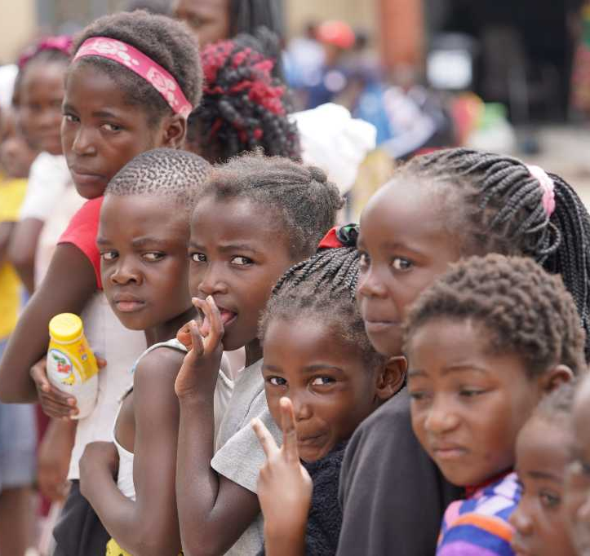
2026-Election Advocacy for Children
National Prosecutors Conference
17 March 2026
Protecting and Promoting Children’s Rights Before, During and After Elections

Slide 2
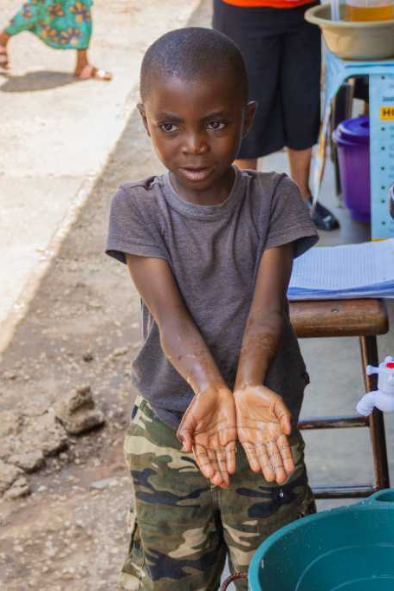
Context
Tripartite Elections scheduled for 13 August 2026. Parliament dissolves in May
While children are not voters, elections can expose children to risks including violence, exploitation and trauma.
Political competition, youth mobilization, misinformation and isolated violence are expected to rise.
Opportunity to advocate for child rights and protection within a rights-based framework.
UNICEF – Prosecutors must uphold neutrality, impartiality and non-partisanship.
Notes:
General elections are due to be held in Zambia on 13 August 2026 to elect a president, members of the national assembly, councillors and council chairs.^{[1]}

Slide 3
Key Risks to Children/ reputational risks
Child Exploitation in Political Activities - Use of children in campaigns, rallies, or messaging, use of children for chanting, wearing regalia, exposing them to harm and manipulation.
Exposure to Violence and Insecurity - Election-related tensions and violence threatening children’s safety and wellbeing. Children present in or near rallies, protests, crowd disturbances.
Disruption of Education Services - Use of schools as polling or campaign venues, affecting access to learning.
Online and Media-Related Harm - Exposure to misinformation, hate speech, and harmful political content, misuse of children’s images and exposure to harmful online political content.
Psychosocial Distress – Stress from abusive language can happen without conflict or instability but can be multiplied in these circumstances. Fear, and trauma caused by political instability and community conflict.
Neglect - Young children left unsupervised as caregivers attend political events.

Slide 4
Purpose of the Election Advocacy
Ensure
children’s rights are protected and respected before, during and post-elections.
Promote
child protection and safeguarding in the electoral context.
Support
healing and recovery for children affected by election-related violence (MHPSS).
Engage
key national stakeholders around a child-centered election agenda.

Slide 5
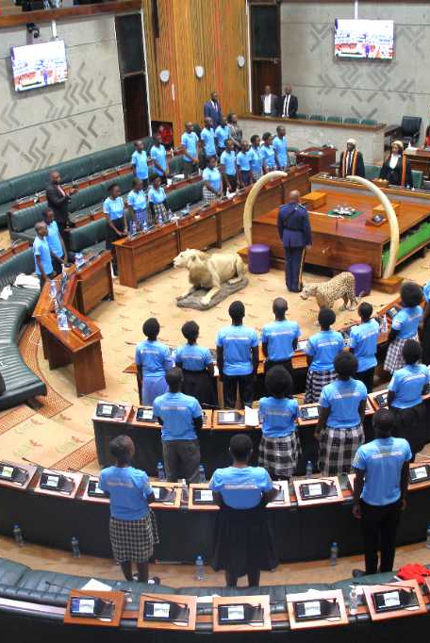
Guiding Principles
Neutrality: UNICEF does not align with any political party, political group or candidate
Impartiality: Advocacy based solely on children’s rights and needs.
Non-partisanship: No endorsement or opposition of political actors.
Do No Harm and Chil Safeguarding at all times.

Slide 6
Advocacy Pillar 1: Promoting Children’s Rights, icl. agency
Advocate
for child-sensitive policies and campaigns before, during and after elections.
Promote
the Children’s Code Act as the guiding framework.
Encourage
political parties to commit to child rights in their manifestos.
Engage
the ECZ on child-friendly electoral processes
Consult and offer children a platform to express their views and co-create the manifesto.
Notes:
ECZ: Electoral Commission of Zambia

Slide 7
Advocacy Pillar 2: Child Protection and Safeguarding
Prevent and respond
to violence against children linked to elections.
Strengthen
referral pathways for child protection cases.
Coordinate
with MCDSS, Child-Helpline Zambia, Police and civil society partners.
Raising Awareness
And disseminate safeguarding messages through media and community platforms.

Slide 8
Advocacy Pillar 3: Post-Election Trauma Healing
Provide
psychosocial support to children affected by election-related violence.
Map
psychosocial service providers & professionals across Zambia.
Strengthen
referral and coordination mechanisms for PSS services.
Advocate
for inclusion of child-focused PSS in post-election recovery efforts.
Notes:
PSS: psychosocial services

Slide 9
Strategic Partnerships
Electoral Monitoring Groups– to include child-sensitive electoral processes.
Media houses and journalists – responsible and child-sensitive reporting.
SACCORD – civic engagement and peacebuilding.
Child-Helpline Zambia – reporting and response to child protection cases and provision of psychosocial first aid.
MCDSS – Line ministry and access to provincial and district set-ups.
Civil Society Organizations – JFA, National Democratic Institute
Police, Judiciary, Prosecutors – accelerated access to justice process for children
UN Sister Organizations, UNDP, UNDSS etc – to leverage their electoral platforms
Notes:
SACCORD Zambia, officially known as the Southern African Centre for the Constructive Resolution of Disputes, is a leading peacebuilding and governance organization in Zambia. Established in 1999, SACCORD is dedicated to promoting peace, security, democracy, and human rights across Zambia and the Southern African region.

Slide 10
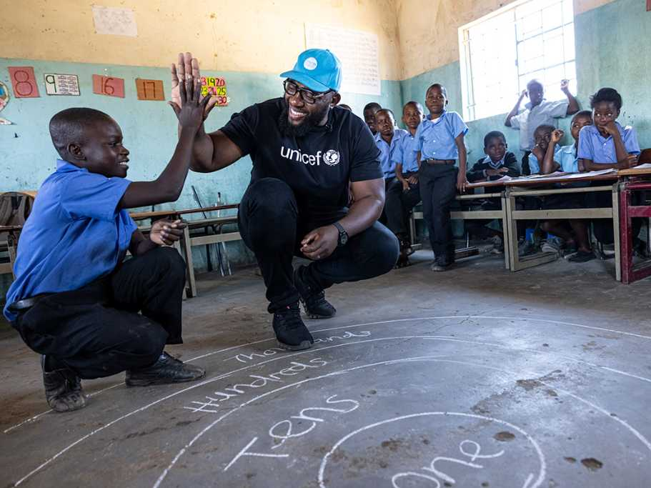
Key Approaches

Slide 11
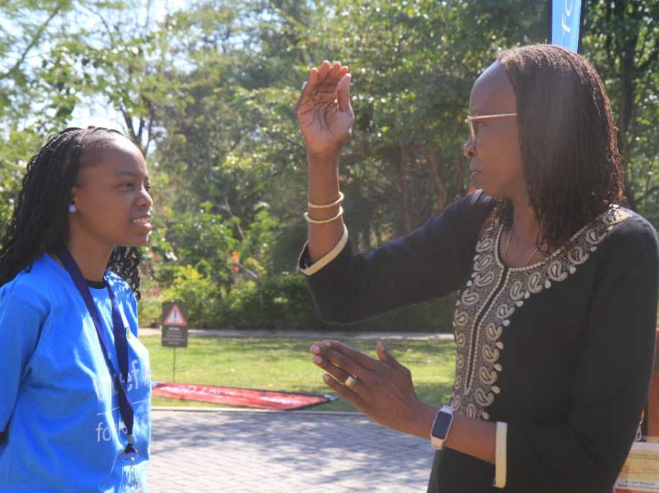
Capacity Building for Media
Train
journalists on child-sensitive and ethical reporting.
Prevent
harmful exposure of children in election-related coverage.
Promote
responsible reporting on violence involving children.
Develop and disseminate
media guidelines on children and elections

Slide 12
Children’s Consultative Campaign
Conduct
consultations with children across the ten provinces
Ensure
inclusive participation of marginalized and vulnerable children.
Document
children’s priorities, concerns and recommendations.
Safeguard
children throughout the consultation process.
Deploy
U-Report polls for children to express their expectations and views, contribute to the manifesto
Disseminate
Findings and views expressed by children on different platforms incl. social media and with different stakeholders (media, parties, etc)
Notes:
Collaborate with MCDSS to identify 10-15 children/province to participate in on-line consultations.

Slide 13
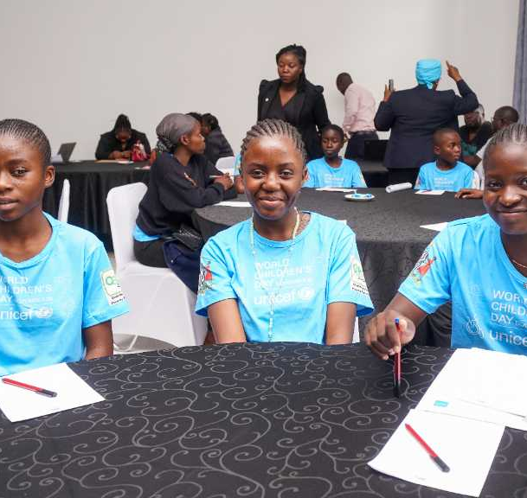
Children’s Manifesto
Develop a child-led manifesto reflecting children’s voices.
Endorsed internally through UNICEF governance mechanisms.
Pitch manifesto for voluntary commitment of political parties.
Use as an advocacy tool while maintaining neutrality.

Slide 14
Communication Campaign
Social Media Engagement
Platforms: Facebook, X, Instagram, LinkedIn
Infographics, short videos, voter education content
Hashtag campaigns, child-rights, myth-busting, live updates
Media Engagement
Radio & TV programmes (public, private and community stations)
Press releases, media briefings, interviews
Media monitoring/SM listening (Talkwalker) and misinformation response
Monitoring & Feedback
Social media analytics and audience feedback
Community call-ins and rapid response mechanisms

Slide 15
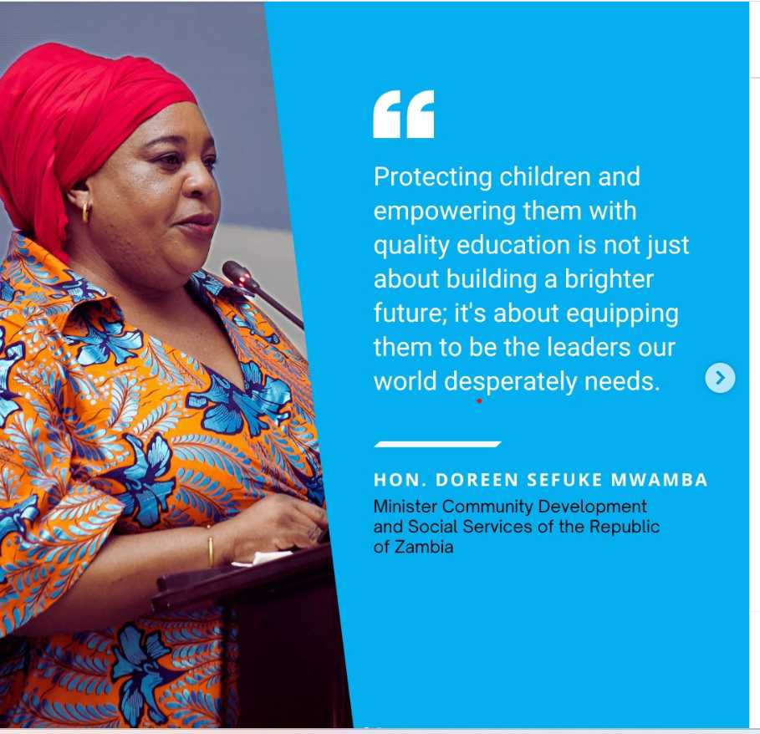
Keeping children Safe during Zambia’s 2026 Elections

Slide 16
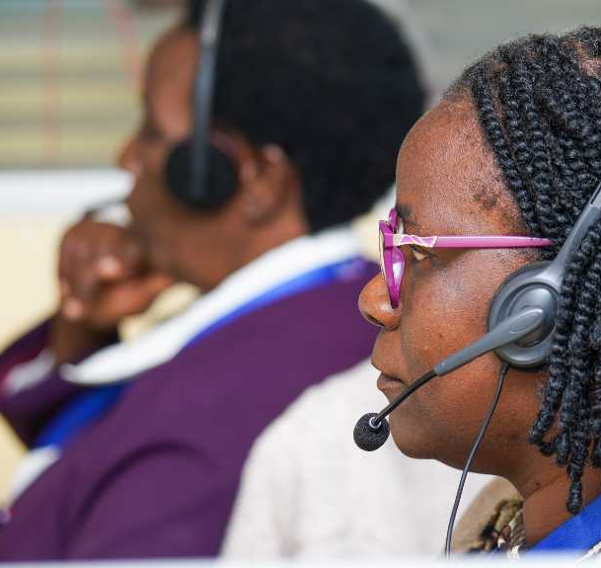
Our Focus
UNICEF Zambia is proactively positioning child protection at the centre of election preparedness and early warning systems to ensure that no child is harmed, exploited, or left behind during the 2026 electoral cycle.

Slide 17
UNICEF Preparedness & Monitoring
Risk & hotspot mapping: Focus on Lusaka, Copperbelt, Southern, Eastern, and select high‑density districts – Social Policy.
Civic & voter education with child lens: Partnering with ECZ, Ministry of Information, media houses –CAP/Social POLICY/Education.
Strengthened reporting systems: Child Helpline 116, Police VSU, ZICTA, MCDD (Social Welfare Officers), CSO observers.
UNCT Prevention Platform: Integrated early warnings + real‑time analysis of incidents affecting children – Leverage UNDP/UNDSS Platforms.
Programme continuity: Ensuring critical social services for children - child protection, wash, nutrition health and education services operate during disruptions – all sections.

Slide 18

Election‑Period Response
Real‑time monitoring via helpline, social listening, CSO observers and district structures.
Referral pathways activated violence, neglect, exploitation, digital safety concerns.
Rapid advocacy targeting authorities, media and community structures.
Daily analysis & escalation through UN system coordination structures.
Notes:
Social Media Listening: Talkwalker.

Slide 19
Post‑Election Priorities
Joint child‑rights assessment with ECZ, HRC, Police VSU, ZICTA and CSOs.
Strengthening case management for affected children.
Integrating lessons into future election preparedness frameworks.

Slide 20
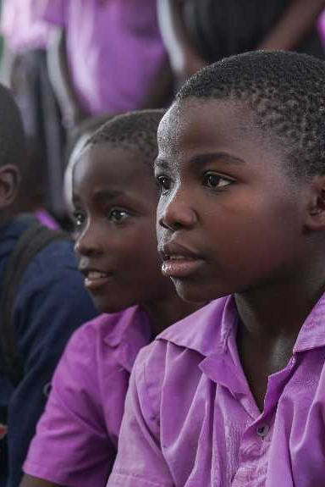
Legal and policy references
Children’s Code Act — protection, participation, privacy.
Penal Code — exploitation, assault, harassment.
Cybersecurity & Cybercrimes / ICT Acts — online harms, preservation.
ECZ Electoral Code of Conduct — children in political activities; polling stations.
Evidence Act / Criminal Procedure — child-friendly testimony; in-camera.
CRC & African Charter on the Rights and Welfare of the Child (ACRWC) — standards guiding prosecutorial discretion & safeguarding.

Slide 21
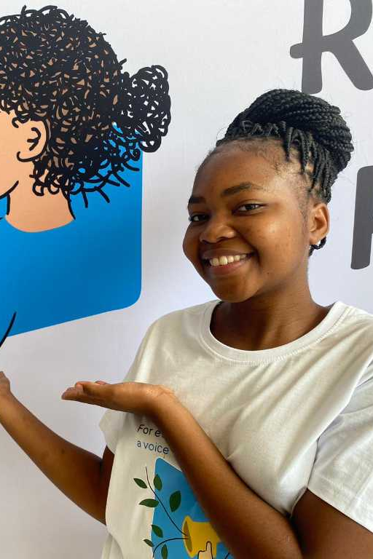
What prosecutors can do
Ensure child-sensitive justice procedures and uphold the best interests of the child: Apply child-friendly justice standards when handling election-related cases involving children as victims, witnesses, or children in conflict with the law ensuring that prosecutorial decisions prioritize the best interests, safety, dignity, and rights of the child, particularly in cases arising from election-related protests, violence, or political mobilization.
Promptly review and prosecute election-related offenses involving children: Prosecutors should promptly review and prosecute cases involving violence, intimidation, coercion, or exploitation of children during elections, and investigate and prosecute adults who exploit children for political purposes, including political actors, campaign agents, or others who recruit, coerce, or manipulate children to participate in political violence, unlawful demonstrations, or electoral misconduct.
Notes:
Ensure child-sensitive justice procedures and uphold the best interests of the child: Apply child-friendly justice standards when handling election-related cases involving children as victims, witnesses, or children in conflict with the law, ensuring that prosecutorial decisions prioritize the best interests, safety, dignity, and rights of the child, particularly in cases arising from election-related protests, violence, or political mobilization.
Promptly review and prosecute election-related offenses involving children: Prosecutors should promptly review and prosecute cases involving violence, intimidation, coercion, or exploitation of children during elections, and investigate and prosecute adults who exploit children for political purposes, including political actors, campaign agents, or others who recruit, coerce, or manipulate children to participate in political violence, unlawful demonstrations, or electoral misconduct.

Slide 22
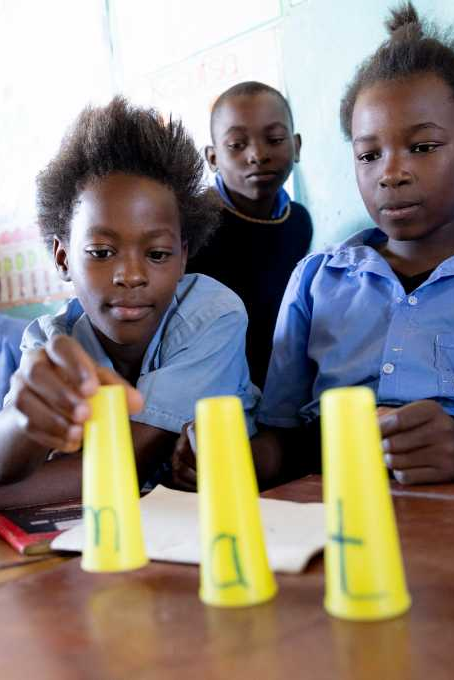
What prosecutors can do
Safeguard child witnesses in election-related cases: Ensure that children who witness electoral violence, political intimidation, or illegal campaign activities provide testimony in safe, confidential, and child-friendly environments, such as through in-camera hearings or recorded statements, to protect them from fear, retaliation, or political pressure.
Apply diversion and restorative justice for children involved in political activism: Where children are arrested or charged due to participation in political demonstrations, protests, or campaign-related activities, prosecutors should consider diversion, counseling, community service, or restorative justice mechanisms rather than punitive prosecution.
Notes:
Safeguard child witnesses in election-related cases: Ensure that children who witness electoral violence, political intimidation, or illegal campaign activities provide testimony in safe, confidential, and child-friendly environments, such as through in-camera hearings or recorded statements, to protect them from fear, retaliation, or political pressure.
Apply diversion and restorative justice for children involved in political activism: Where children are arrested or charged due to participation in political demonstrations, protests, or campaign-related activities, prosecutors should consider diversion, counseling, community service, or restorative justice mechanisms rather than punitive prosecution.

Slide 23
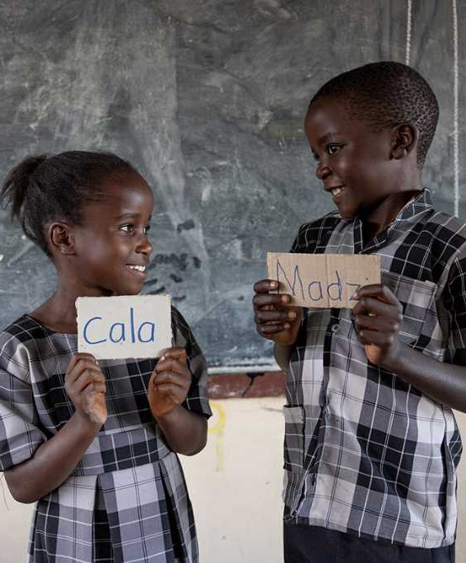
What prosecutors can do
Ensure detention is used only as a last resort: Advocate for non-custodial measures and ensure that children involved in election-related offenses are not unnecessarily detained, in line with children code act that require detention to be used only as a measure of last resort and for the shortest possible period.
Guide investigators on child-friendly evidence collection and strengthen awareness: Provide direction to investigators on proper documentation of election-related offenses involving children, ensuring that evidence is collected in a child-sensitive manner while preserving the integrity and admissibility of evidence in court, and support training and awareness on child protection during elections by promoting capacity-building for justice sector actors, including prosecutors, police, and electoral officials.
Notes:
Ensure detention is used only as a last resort: Advocate for non-custodial measures and ensure that children involved in election-related offenses are not unnecessarily detained, in line with children code act that require detention to be used only as a measure of last resort and for the shortest possible period.
Guide investigators on child-friendly evidence collection and strengthen awareness: Provide direction to investigators on proper documentation of election-related offenses involving children, ensuring that evidence is collected in a child-sensitive manner while preserving the integrity and admissibility of evidence in court, and support training and awareness on child protection during elections by promoting capacity-building for justice sector actors, including prosecutors, police, and electoral officials.

Slide 24
Child Used in Campaign Regalia at Rally
Scenario: 12-year-old filmed chanting in party regalia on a truck; video goes viral.
Risks? Actions?
Notes:
Maintain neutrality; focus on legality and child safety.
Risks: exploitation, exposure to crowd violence, online doxxing (revealing identifying information about someone online); privacy violations.
Actions: safety check; assess offences (use of child in political activity, endangerment); media non-disclosure; secure original video evidence; consider diversion for adult actors vs. prosecution.

Slide 25
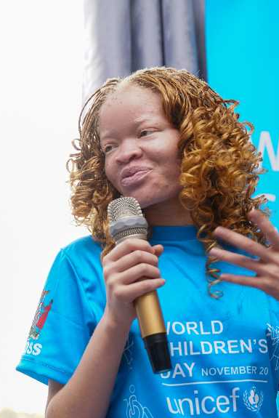
Expected Results
Improved protection of children before, during and after elections.
Increased accountability of political actors to child rights.
Enhanced media reporting that safeguards children.
Strengthened national capacity for child-focused psychosocial support.

