Slide 1
CHILDREN AND YOUNG PERSONS’ INVOLVEMENT IN CADERISM AND ELECTORAL VIOLENCE: ITS IMPACT ON THE COMMUNITY AND PREVENTION STRATEGIES
Presented By: Monde Muyoba- Chizongo (Senior State Advocate, Gender-Based Crimes and Child Protection Department)
National Prosecution Authority
4th Annual Prosecutors’ Conference- 16th to 18th March, 2026- Mulungushi Conference Centre

Slide 2
Introduction
Elections are the cornerstone of democratic governance. Yet, in many contexts, children and young persons are increasingly drawn into political caderism and electoral violence. Their involvement exposes them to harm, exploitation, and conflict with the law, while also creating complex legal and ethical challenges for prosecutors responsible for safeguarding both democratic integrity and the rights of children.

Slide 3
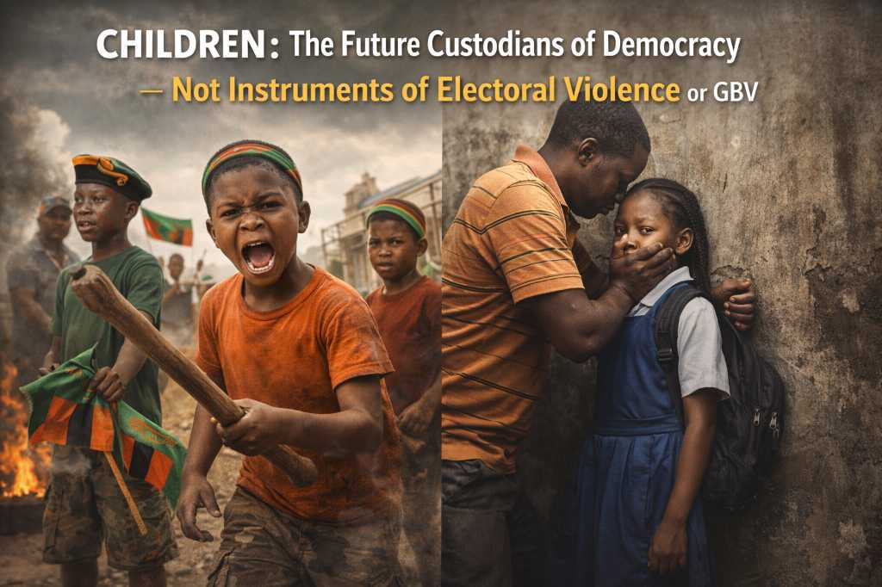

Slide 4
Defintion of child: who is a Child?
Article 266 of the Constitution (Amendment) Act, No. 13 of 2025, defines a child as follows:
“A child is a person who is below the age of eighteen (18).”
This definition means that any person who is below the age of 18 is considered a child. A person ceases being a child on their 18th birthday.

Slide 5
Definition of a Young Person
Article 266 of the Constitution (Amendment) Act, No. 2 of 2016, defines a child as follows:
“a person who has attained the age of fifteen years, but is below the age of nineteen years; and

Slide 6
Understanding Political Caderism and Electoral Violence
POLITICAL CADERISM
ELECTORAL VIOLENCE
The mobilisation and use of organised groups of party supporters, often called cadres, to advance political interests.
Acts of coercion, intimidation, harassment, or physical harm aimed at influencing electoral processes or outcomes
can occur before elections, during campaigns, during elections and after elections

Slide 7
Use of Children to Influence Electoral Processes
Key Patterns of Exploitation in Political Contexts

Slide 8
Direct Political Mobilisation of Children
Recruitment as political cadres to intimidate voters or rivals.
Participation in electoral violence (stone throwing, disruptions, attacks, assaults, malicious damage to property, hate speech online e.t.c. )
Transporting children to rallies to create the appearance of mass support.
Wearing party regalia, chanting slogans, and mobilising crowds.

Slide 9
Indirect Influence on Electoral Outcomes
Use of children in campaign propaganda and political messaging.
Online mobilisation and spreading political messaging on social media.
Use of children to deliver money or goods in vote‑buying schemes.
Symbolic participation (school visits, staged events) to legitimise political actors.

Slide 10


Legal and Policy Framework
The Constitution of Zambia
The Children’s Code Act
The Penal Code
The Anti-Gender-Based Violence Act
The Cyber Crimes Act
The Electoral Process Act

Slide 11
Impact of Electoral Violence on Children
PSYCHOLOGICAL AND EMOTIONAL HARM Exposure to violence can cause trauma, fear, anxiety, and long-term psychological distress. Children may grow up normalising violence as a means of resolving political differences.
DISRUPTION OF EDUCATION AND DEVELOPMENT Recruitment into political activities often pulls children out of school. Lost education limits future opportunities and social mobility.
EXPLOITATION AND MANIPULATION Children are sometimes used as political cadres, mobilised to intimidate opponents or disrupt political events. This constitutes child exploitation and abuse of vulnerability
EXPOSURE TO PHYSICAL HARM Children involved in violent political activities risk assault, injury, or death. They may also be exposed to weapons, mobs, and unsafe environments.
CRIMINALISATION OF CHILDREN Participation in political violence may bring children into conflict with the law, leading to arrest or prosecution. This can create long-term stigma and barriers to rehabilitation.
UNDERMINING DEMOCRATIC VALUES When children are socialised into violent politics, they learn that intimidation and violence are acceptable political tools, weakening respect for the rule of law and democratic processes.

Slide 12
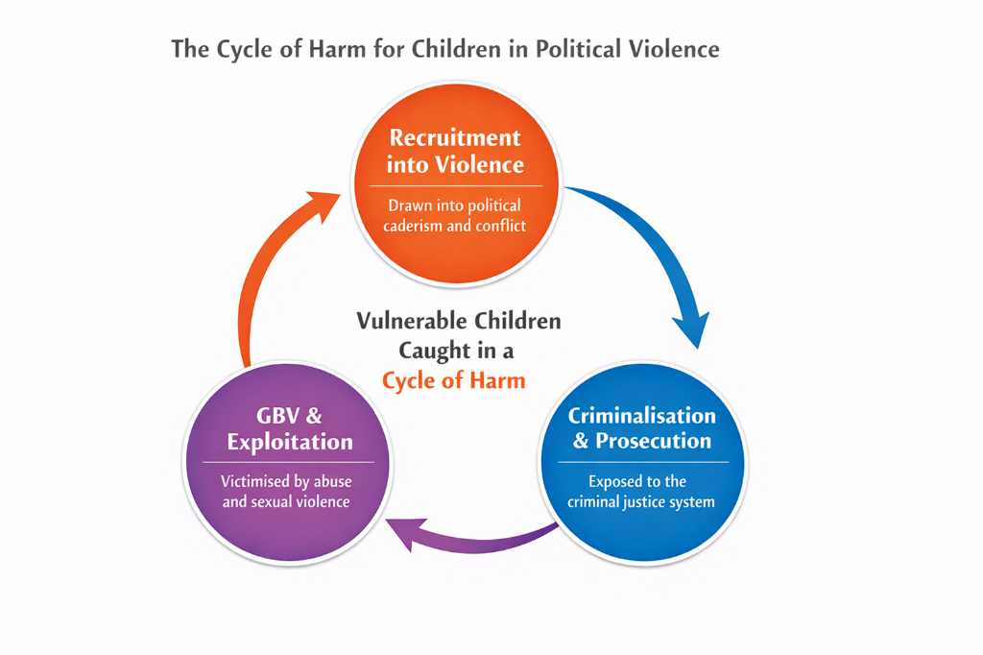

Slide 13
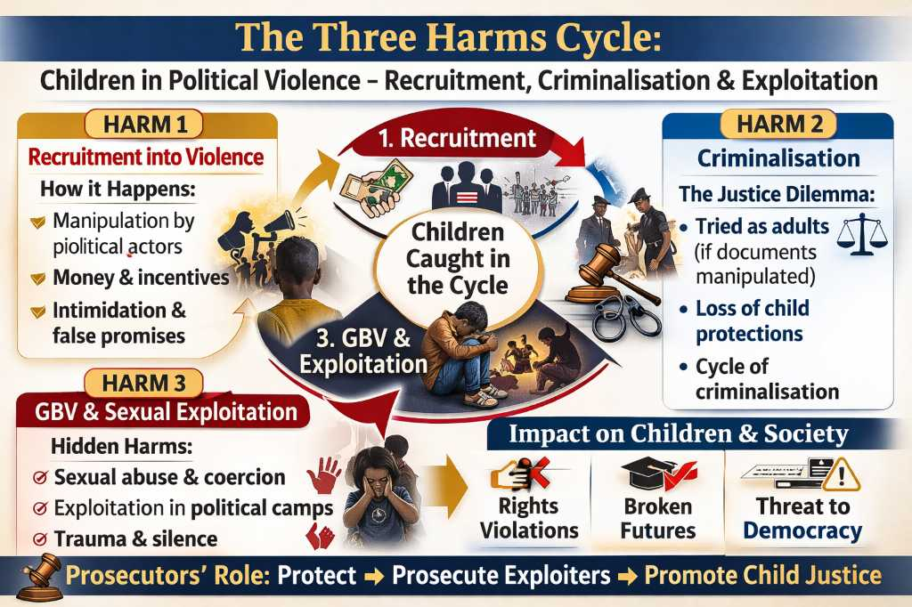

Slide 14

SEXUAL AND GENDER-BASED VIOLENCE AS A FORM OF ELECTORAL VIOLENCE
ELECTION CONTEXT | HOW EXPOITATION OCCURS | RISK TO CHILDREN
Political Campaign Structure | Political organisers, campaign officials, community leaders, or older cadres abuse positions of power over children involved in campaigns. | Coercion into sexual acts in exchange for money, protection, food, transport, or political favours.
Transactional/ Survival Situations | Children involved in campaign activities depend on political actors for financial support or resources. | Pressure to exchange sex for money, alcohol, gifts, or access to political networks.
Electoral Violence | Political clashes and intimidation create chaotic and unsafe environments. | Sexual assault, harassment, and abuse used to intimidate communities or rival supporters.
Campaign Activities and Rallies | Late-night meetings, alcohol consumption, crowded rallies, and unsupervised transport arrangements | Increased risk of sexual harassment, coercion, and assault, especially for girls.
Online Political Spaces | Children mobilised through social media to participate in political attacks or harassment campaigns | Sexualised insults, cyberbullying, threats of sexual violence, and sharing of private images.

Slide 15
Realities of Child Exploitation used in Political/Electoral Violence- Case Study of a 14-Year-Old Boy
Facts
Child aged 14charged with an offence of Breaking into a Building and Committing a Felony therein.
Physically appeared
National Registration Card indicated that he was 21 years old.
During age determination, the father alleged child was recruited in 2021 to register as a voter at age 12.
Father could not prove the allegations, so the child had to be treated as an adult.
Impact
The child was tried and sentenced as an adult.
Despite appearing as a child, the law relied on documentation, not physical appearance.
The child bore the full consequences while the recruiters went free.
Education interrupted, dreams shattered, future disrupted.

Slide 16
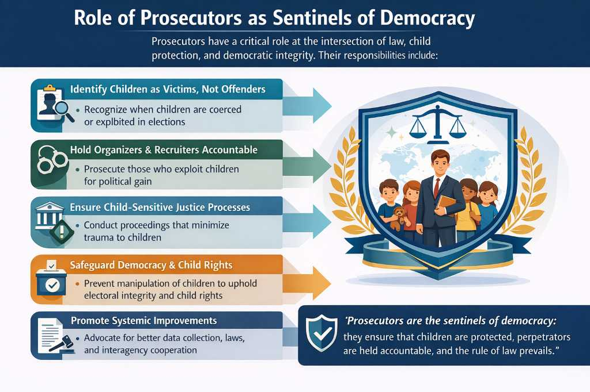

Slide 17
Strategies for Prosecutors
Charge the adults who recruited the children for the underlying offences. The adults may not have directly participated in the offences, but recruited children to execute the offences for them. Sections 21 and 22 of the Penal Code would enable you to charge the adults as the masterminds.
Frame the conduct as child exploitation. Charge the adults for child maltreatment and exploitation under section 17 of the Children’s Code Act as read with section 27.
Depending on the circumstances of the case, you may criminalise the offences and decide to either prosecute or divert the case. Remember, children are victims first, before being considered in conflict with the law.

Slide 18
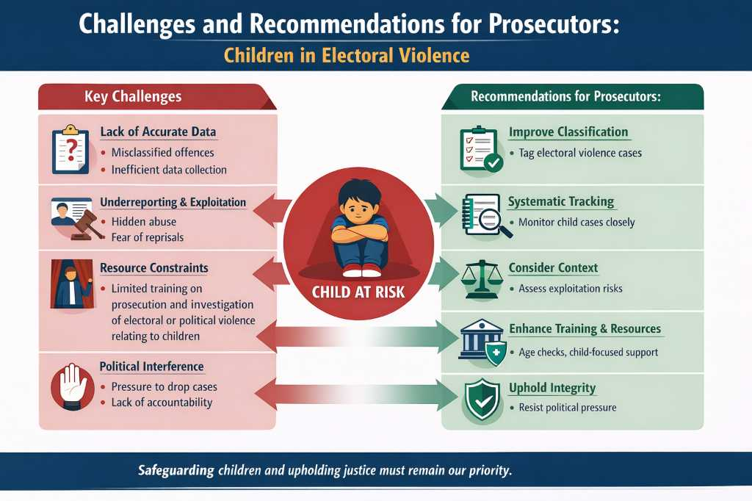

Slide 19
Other Recommendations
Advocate for legislation that expressly prohibits the use of Children in electoral violence
The African Committee of Experts on the Rights and Welfare of the Child (ACERWC), an Organ of the African Union (AU) established to monitor the protection of children’s rights on the continent- Guidelines on Children’s Rights during Election Periods
Any form of harm caused to the child, be it through harmful practices intended for manipulating election results or through instigating and participating in election-related violence, should be subject to criminal sanctions, with appropriate forms of punishment as prescribed by law.
Children found to be implicated in election-related violence should not be subjected to the same criminal penalties as adults.

Slide 20
Zimbabwean Constitution
Article 81 (h) Every child, that is to say every boy and girl under the age of eighteen years, has the right not to be compelled to take part in any political activity;

Slide 21
Action Points for Prosecutors
Proactively identify child exploitation in political contexts before criminalisation.
Hold political actors accountable for recruitment or abuse of children.
Ensure child-sensitive justice using diversion in accordance with the Children’s Code Act.
These actions help break the cycle of harm and protect vulnerable young persons.

Slide 22

CONCLUSION!
Children must never be used as instruments of electoral violence.
Protecting children is not only a moral duty, it is also essential to safeguarding democracy.
Prosecutors stand at the frontline, ensuring electoral integrity, defending child rights, and upholding the trust of our communities.
Notes:
Role Play Objective: To practice applying developmental knowledge and trauma-informed approaches when interacting with a child involved in the justice system, either as a victim, witness, or child in conflict with the law.

Slide 23
“JUSTICE IS NOT ONLY MEASURED BY HOW WE PUNISH THE GUILTY, BUT BY HOW WE PROTECT THE INNOCENT, THE CHILDREN WHO ARE DRAWN INTO ELECTORAL VIOLENCE AND EXPLOITED FOR POLITICAL GAIN.”

Slide 24
THANK YOU!!

