Slide 1



Post‑Election Violence: Strategies in Prosecuting Electoral Violence
2026 ANNUAL PROSECUTORS’ CONFERENCE
Notes:
Introduce yourself and explain the purpose of the training session.

Slide 2
Introduction
Prosecuting electoral violence in court presents several practical challenges because these cases often involve political tension, many perpetrators, and frightened witnesses. So in this presentation we will:
Understand electoral violence and its impact on democracy
Examine the legal framework for prosecuting electoral offences in Zambia
Identify practical prosecutorial strategies
Review real case studies from Zambian courts
Notes:
Explain what participants should learn from the training.

Slide 3


Understanding Electoral Violence
Electoral violence refers to acts of intimidation, coercion, or physical harm committed before, during, or after elections to influence electoral outcomes.
Notes:
Define electoral violence and its context in democratic elections.

Slide 4



Why Prosecuting Electoral Violence Matters
Protects democratic processes
Promotes accountability
Deters political violence
Strengthens public confidence in elections
Notes:
Explain why prosecuting such offences is important for democracy.

Slide 5

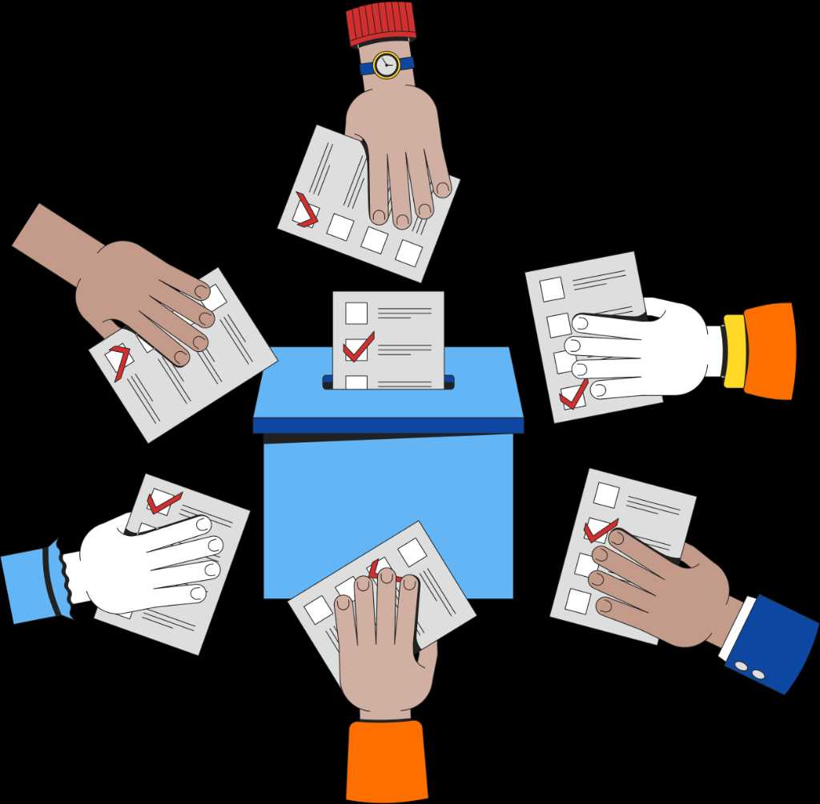

Common Forms of Electoral Violence
Assault and physical attacks
Voter intimidation
Destruction of campaign materials
Arson and property damage
Disruption of polling processes
Now we are seeing mis-information using digital platforms
Notes:
Discuss the various forms electoral violence can take.

Slide 6


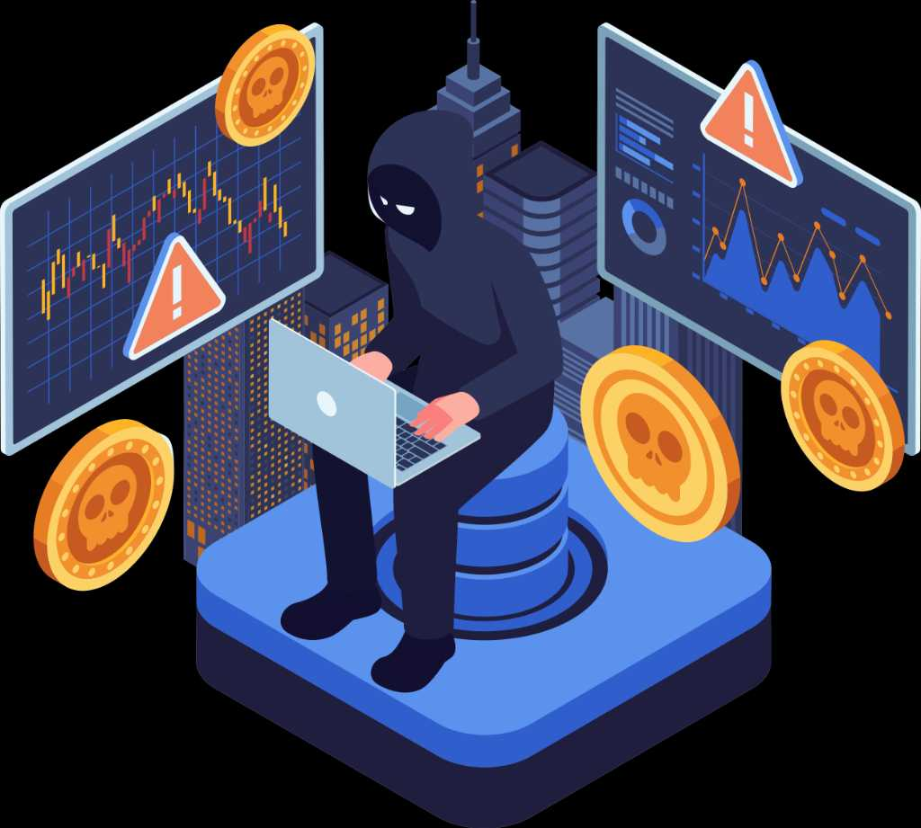
Legal Framework in Zambia
Penal Code
Electoral Process Act
Criminal Procedure Code
Cyber Crimes Act
Constitutional provisions on free and fair elections
Notes:
Highlight the main laws prosecutors rely on in Zambia.

Slide 7
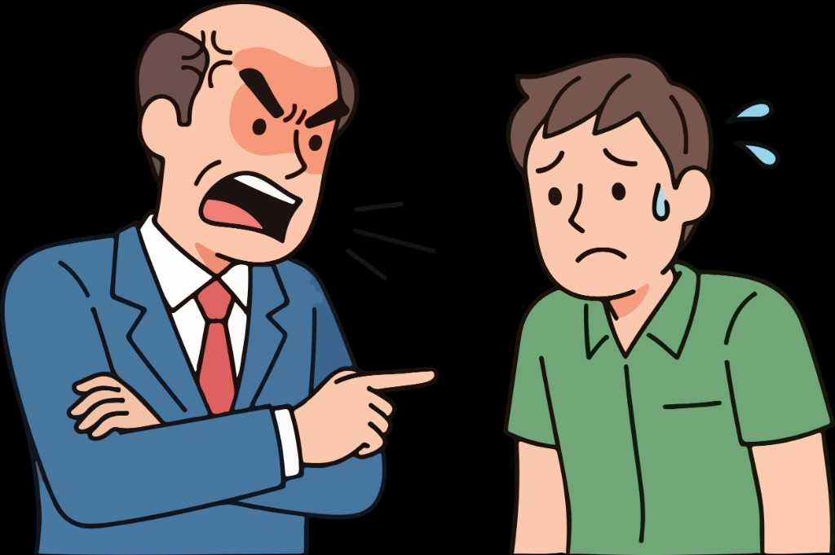

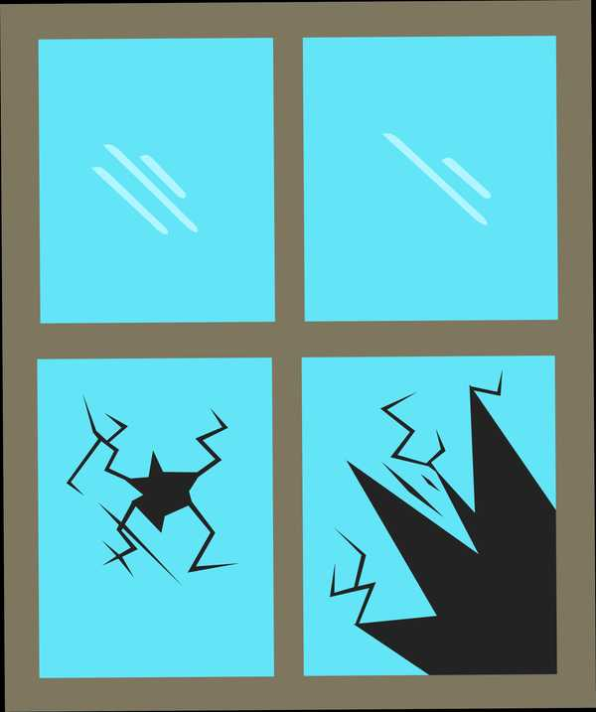
Key Electoral Offences
Violence or intimidation of voters
Bribery and undue influence
Destruction of property and electoral materials
Disorderly conduct at polling stations
Notes:
Explain offences specifically related to elections.

Slide 8
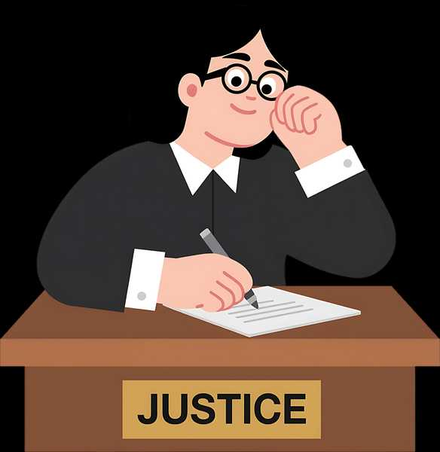
Role of the Prosecutor
Ensure fair and impartial prosecution
Review and assess evidence
Guide investigators
Present evidence effectively in court
Notes:
Discuss the professional responsibilities of prosecutors.

Slide 9
Challenges and strategies
1. Witness Intimidation and Hostility: Witnesses in electoral violence cases may;
Fear retaliation from political cadres;
Withdraw statements or become hostile witnesses during trial; and
Refuse to testify due to political pressure.
Strategy
Ensure that detailed statements are recorded; Use prior inconsistent statements to challenge hostile witnesses; and
Request court protection measures where necessary.
Notes:
Explain the importance of early case review and planning.

Slide 10

Political Influence and Public Pressure
Attempts to influence witnesses;
Pressure on investigators or prosecutors; and
Public perception that the prosecution is politically motivated.
Strategy
Ensure prosecutions are strictly evidence based;
Maintain prosecutorial independence and neutrality; and
Clearly demonstrate the legal basis for the charges.

Slide 11

Weak or Incomplete Investigations
Sometimes police investigations maybe inadequate due to;
Poor collection of evidence at the crime scene;
Failure to secure medical reports or damaged property evidence; and
Lack of proper documentation.
Strategy
Work closely with investigators before trial;
Request further investigations if necessary; and
Ensure all elements of the offence are supported by evidence.

Slide 12

Delays in Court Proceedings
Electoral violence cases may suffer delays due to:
Numerous witnesses;
Adjournments requested by the defence; and
Overloaded court schedules.
Strategy
Apply for expedited hearings;
Organise witnesses properly before trial; and
Avoid unnecessary adjournments.

Slide 13

Hostile or Contradictory Testimony
Witnesses may
Change their version of events;
Contradict their police statements; and
Claim they were forced to give statements.
Strategy
Cross-examine the witness on previous statements; and
Call additional witnesses to corroborate evidence.

Slide 14

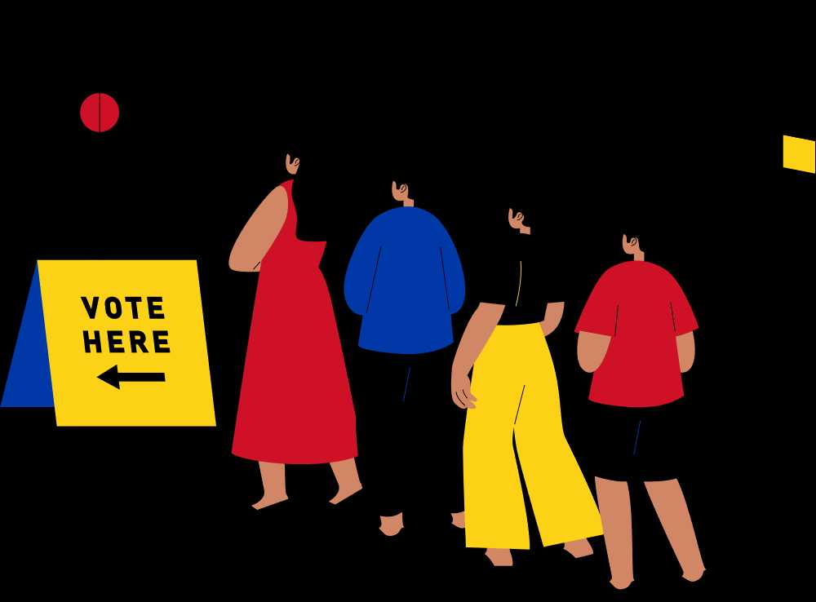
Proving the Link Between Violence and Elections
In some cases, the defence may argue the violence was ordinary criminal conduct and not election-related.
Strategy
Present evidence showing the offence occurred:
During campaigns, polling, or results announcement;
Between rival political supporters; and
In connection with electoral activities.

Slide 15

Managing Large Numbers of Accused Persons
Electoral violence cases may involve multiple accused persons, which creates difficulties such as:
Longer trials;
Conflicting defences; and
Complicated evidence presentation.
Strategy
Clearly organize evidence against each accused; and
Prove individual participation or common intention where applicable.

Slide 16

Difficulty in Identifying Accused Persons
Poor lighting conditions during incidents;
Witnesses only seeing perpetrators briefly; and
Accused persons claiming mistaken identity.
Strategy
Use identification parades;
Rely on video evidence, photographs, or social media recordings; and
Corroborate eyewitness evidence with other evidence.

Slide 17

Witness Management
Record statements early
Address intimidation risks
Prepare witnesses for testimony
Ensure credibility and consistency
Notes:
Explain how witnesses should be managed and protected.

Slide 18

Inter‑Agency Collaboration
• Police investigators
• Electoral authorities
• Medical personnel
• Civil society election monitors
Notes:
Discuss cooperation between prosecutors and other institutions.

Slide 19

Case Study: Mulobezi By‑Election Violence
Violence during the 2015 by‑election led to serious criminal charges and imprisonment, demonstrating that electoral violence can attract custodial sentences.
Notes:
Explain the Mulobezi case and its importance in electoral violence prosecution.

Slide 20

Case Study: Kawambwa By‑Election Incidents
Political actors faced charges for assault and breach of peace during election‑related violence, illustrating accountability regardless of status.
Notes:
Discuss the Kawambwa incidents as an example of prosecuting political actors.

Slide 21

Case Study: Kabushi Parliamentary Election
Violence during campaigns contributed to the nullification of an election after court findings on intimidation and misconduct.
Notes:
Explain how electoral violence may lead to election nullification.

Slide 22
Conclusion
The major courtroom challenges in prosecuting electoral violence in Zambia includes;
Witness intimidation,
Identification difficulties,
Political pressure,
Weak investigations and political delays.
Effective prosecution of electoral violence through strong preparation and careful presentation of evidence in court overcomes these challenges and promotes accountability, protects democratic institutions, and strengthens the rule of law in Zambia.
Notes:
Discuss practical challenges prosecutors face in these cases.

Slide 23
Thank you for your attention
Notes:
Discuss practical challenges prosecutors face in these cases.

