Slide 1

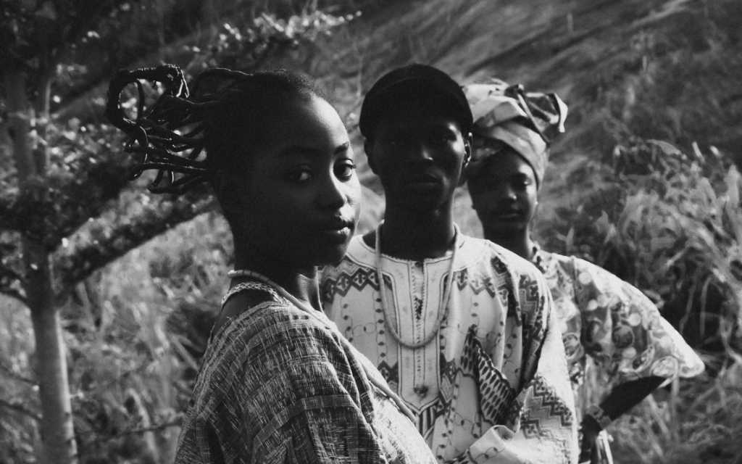

4TH NATIONAL ANNUAL PROSECUTORS' CONFERENCE
The Intricacies of Violence and Discrimination Against Women in Elections
Digital Safety and Prevention of Technology-Facilitated Gender-Based Violence in Electoral Processes
Presented by Tapiwa Nyasulu · Lusaka, Zambia · 16–18 March 2026
"Prosecutors as Sentinels of Democracy: Ensuring Inclusivity, Electoral Integrity and the Rule of Law"
Notes:
1

Slide 2
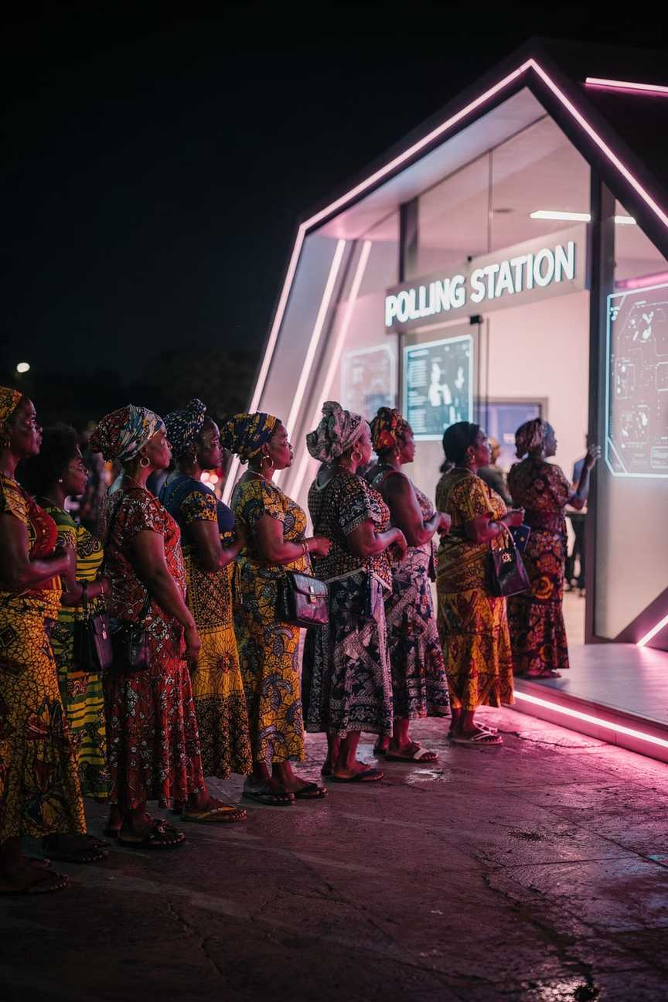

SETTING THE SCENE
Why This Matters
Zambia's Electoral Reality
The Urgent Stakes
Violence Against Women in Elections (VAWE) does not merely harm individual women — it corrodes democratic integrity at its foundation. With Zambia's 2026 general elections approaching, the window for action is now.
Women constitute the majority of the electorate in Zambia — a trend confirmed in the 2021 general elections. Yet their full participation remains under threat.
“53% of registered voters in previous election were women but still underrepresented” PS Mainga Kabika, Gender Division
Every woman silenced is a vote for democracy suppressed.
Notes:
2

Slide 3
Defining the Problem: VAW in Elections
Violence Against Women in Elections (VAWE) sits at the intersection of political violence and gender-based violence — and it is anything but gender-neutral.
Targeted Because of Gender
A Historical Blind Spot
Gender Norms as Fuel
Until recently, electoral violence was treated as gender-neutral. Research and survivor testimony have dismantled that assumption entirely.
Prevailing gender norms shape the motives, forms, and impacts of this violence — making gender analysis essential to effective prosecution.
Women are targeted specifically because they are women who dare to participate in public and political life — not merely as political opponents.
Notes:
3

Slide 4

VICTIMS & SURVIVORS
Who Are the Victims?
VAWE targets women across the entire electoral ecosystem:
Voters & Candidates
Women exercising their fundamental right to vote or stand for office.
Party Workers & Officials
Campaign staff, elected officials, and political party supporters.
Civil Society & Media
Journalists, CSO activists, election observers — and even their family members.
Women mostly face psychological or sexual violence — not physical
Fear-based violence dominates: threats to personal security, family safety, social ostracism, attacks on moral character and self-confidence
Women are more likely to face sexual harassment within their own political parties or be demeaned in a sexual way
Violence against voters largely occurs at home or in private spaces — and is therefore chronically underreported
Women disproportionately face psychological and sexual violence — fear for personal safety, family threats, social ostracism, and attacks on moral character.
AFFECTED:
Women Voters · Women Candidates · Staff of Public Institutions · Women Political Supporters/Campaign Workers · Women Elected Officials · Women Journalists · Women CSO Activists · Women Observers · Family Members
Notes:
4

Slide 5

EMERGING THREAT
Technology as a New Lever: Tech-Facilitated GBV
New Vehicles of Harm
Anonymity at Scale
ICTs have created unprecedented avenues for VAWE — social media harassment, private messaging abuse, doctored imagery, and coordinated pile-ons.
Online platforms enable perpetrators to act with anonymity, enabling abuse at a scale and speed impossible in offline environments.
A Gendered Weapon
TFGBV differs from harassment of men in intent, frequency, form, content, and impact — designed to silence women through fear, shame, and intimidation.
Notes:
5

Slide 6

The Chilling Effects of TFGBV on Political Participation
Suppresses Leadership
Broad Deterrent Effect
Escalates to Offline Violence
Psychological Abuse
These effects compound one another — a woman who experiences online abuse faces not only immediate harm but long-term barriers to civic and political life, undermining democratic representation at every level.
Notes:
6

Slide 7

EVIDENCE BASE
Global Statistics on Online Violence Against Women
Source: UNFPA— TFGBV Making All Spaces Safe, 2021
38%
74%
90%
Girls & Women Globally
Girls & Women in Europe
Girls & Women in Africa
Have experienced online violence
Have experienced online violence.
Have experienced online violence
Notes:
7

Slide 8
EMERGING THREAT
Statistics on Tech-Facilitated Violence Against Women in Elections in Africa
80%
67%
42%
women parliamentarians interviewed have experienced psychological violence in parliament
subject to sexist behaviour or remarks
received death threats, rape threats, or threats of beating or abduction, usually online
40%
23%
have been sexually harassed
endured physical violence
Source: IPU — Sexism, Harassment and Violence Against Women in Parliaments in Africa, 2021
Notes:
5

Slide 9





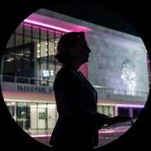
GLOBAL CASE STUDIES
When Online Hate Has Real-World Consequences
Hillary Clinton · USA
Diane Abbott · UK
Jo Cox · UK
Laura Boldrini · Italy
Subjected to systematic online misogyny during the 2016 presidential campaign — coordinated, gendered, and relentless.
Received the highest volume of abusive tweets of any UK Member of Parliament — disproportionately racist and sexist in content.
Online hate speech and harassment escalated to real-world assassination. A stark warning of where digital threats can lead.
Targeted with violent sexual threats online — abuse designed to humiliate, delegitimize, and silence a senior public official.
Julia Gillard · Australia
Dilma Rousseff · Brazil
Subjected to sustained gendered online attacks throughout her tenure as Prime Minister, questioning her authority and legitimacy.
"There has been, mixed in all of this, a large amount of prejudice against women." — Former President Rousseff on the gendered dimension of her political persecution.
Notes:
8

Slide 10





REGIONAL CASE STUDIES
East and Southern Africa: Patterns of Harm
Uganda
Jennifer Semakula Musisi's body was sexualized by media and social media users; her professional achievements were systematically overshadowed by gendered commentary.
Rwanda · 2017
Diane Rwigara's presidential campaign was derailed when doctored nude images were fabricated and shared online — a calculated act of political sabotage.
Malawi · 2019
A woman was stripped for wearing political party regalia. The video was shared via WhatsApp — technology amplifying a physical act of political humiliation.
South Africa · 2024
ISD research documented women politicians subjected to gendered disinformation campaigns across TikTok, X, and Facebook during the general elections.
Zambia
Reported cases of both physical and technology-facilitated violence deliberately targeted at female candidates — underlining the domestic urgency of this issue.
Notes:
9

Slide 11
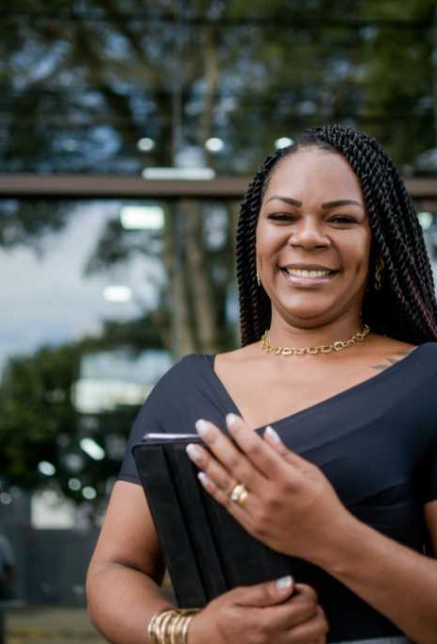
ZAMBIA CASE
Cyberbullying and Assasination of Character: in the past, a candidate faced severe cyberbullying and character assassination initiated by her opponents, who utilized social media platforms to launch personal attacks focused on past marital status.
They propagated the harmful narrative that an experience of divorce was a sign of personal failure, using this as a baseless argument to question competence, moral standing, and overall ability to effectively govern the community. ''
A candidate faced online threats and harassment that escalated into physical intimidation.
Notes:
15

Slide 12
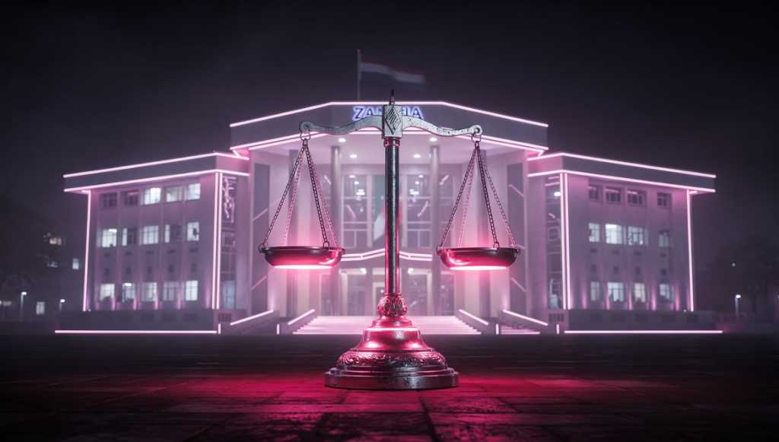




THE ZAMBIA CONTEXT
Legal Frameworks and the Prosecutorial Imperative
Zambia's legal architecture provides the tools — prosecutors must wield them decisively.
Prosecution plays a pivotal dual role: holding perpetrators accountable and deterring future offenders. Fast Track Courts offer a critical mechanism for swift, visible justice ahead of 2026.
Electoral Process Act
Cyber Crimes Act
Penal Code
Notes:
10

Slide 13






MULTI-STAKEHOLDER RESPONSE
The Role of Key Stakeholders
Electoral Management Bodies
Law Enforcement & Prosecutors
Mine data on incidents, provide accessible reporting platforms, and advocate for stronger electoral violence legislation.
Proactively track digital threats, support digital privacy management, and enforce existing legislation with gender sensitivity.
Lawmakers
Political Parties
Enact legal reforms that explicitly recognize online VAWE as GBV and establish robust perpetrator accountability frameworks.
Adopt and enforce internal zero-tolerance policies against violence; actively lobby for legal protections for women members.
Media
Social Media Companies
Publicize cases of online abuse; train journalists to identify and responsibly report VAWIE-Online without re-traumatizing survivors.
Swiftly remove violent content, report cases to authorities, and enforce platform codes of conduct consistently and transparently.
Notes:
11

Slide 14
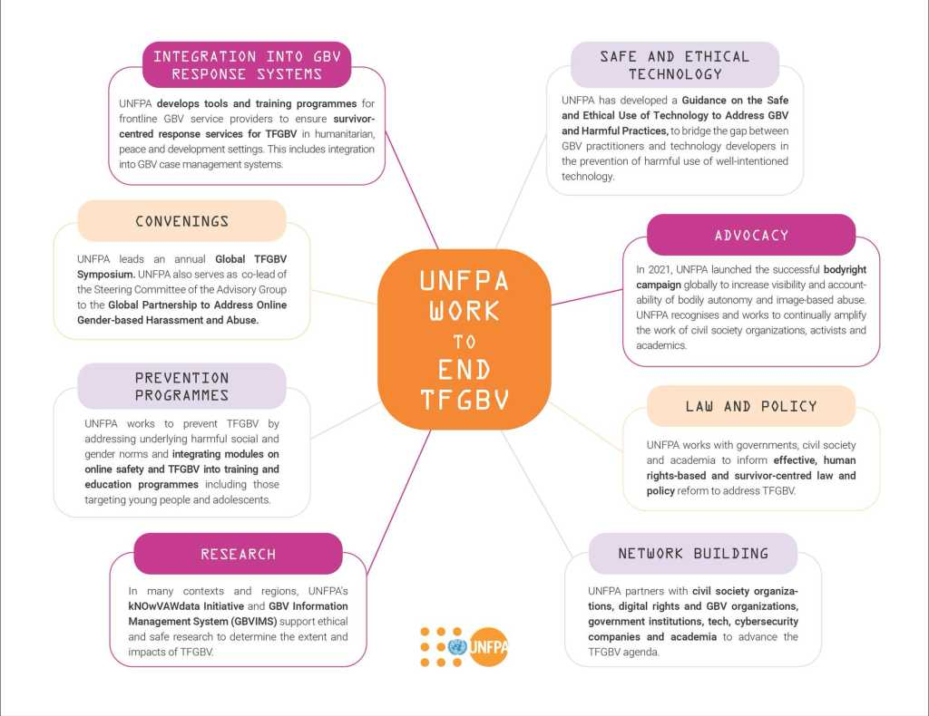

Slide 15

VAWE Reporting Mechanism in Zambia

Slide 16

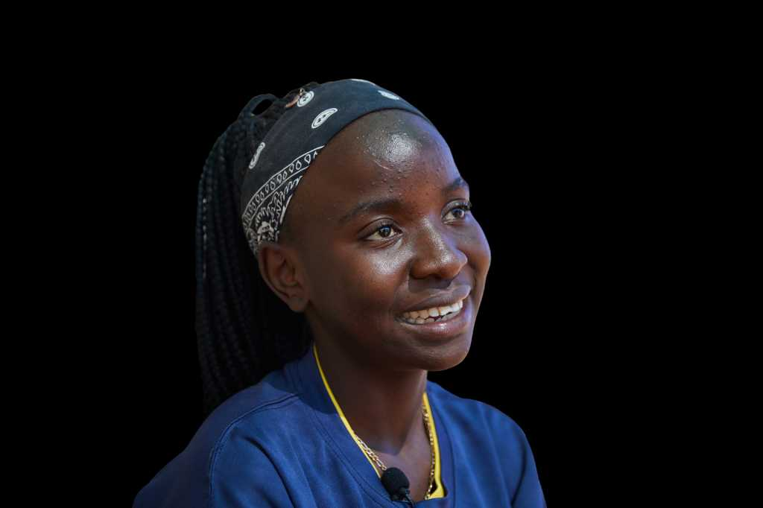
Trauma-Informed Justice: Why It Matters for Prosecutors
Understand Survivor Behaviour
Recognise why survivors may delay reporting, recant, or appear inconsistent — trauma responses, not unreliability.
Communicate More Effectively
Prosecuting TFGBV effectively requires more than legal knowledge — it demands a trauma-informed and survivor-centred approach at every stage of the process.
Build trust with survivors to obtain fuller, more accurate testimony and affidavit evidence.
Prosecutors who adopt this framework are better equipped to serve justice and support their own professional wellbeing.
Strengthen Court Processes
Increase survivor confidence in the justice system, improving participation and case outcomes.
Protect Practitioners
Build institutional frameworks that support prosecutors' own wellbeing when handling distressing cases.
Notes:
12

Slide 17
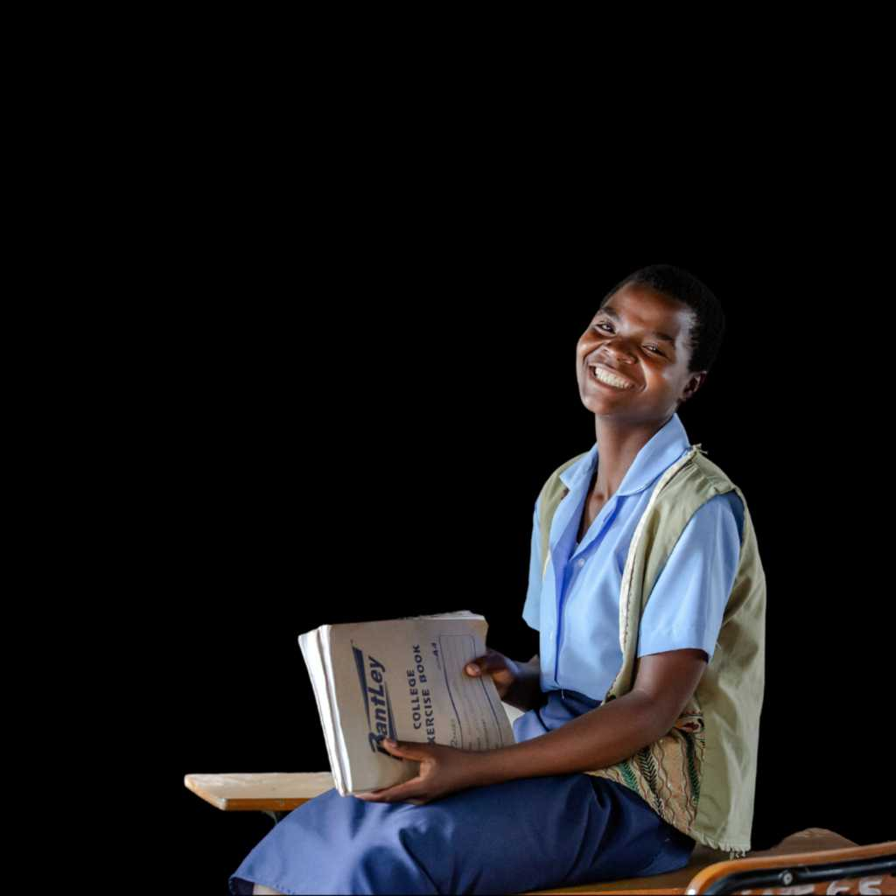
PRACTICAL GUIDANCE
Preserving Digital Evidence: A Checklist for Legal Practitioners
01
01
Capture Full Message Threads
Document Collection Process
Never preserve fragments — full context is essential for establishing intent and pattern of conduct.
Maintain a clear chain of custody record from the moment evidence is identified.
02
02
Strategic Screenshots
Avoid Contamination
Be aware: some applications notify senders when screenshots are taken. Plan evidence capture accordingly.
Do not alter, forward, or engage with content before it has been formally preserved.
03
03
Preserve Multimedia
Engage Digital Forensics
Retain voicemails, photos, and videos in original format. Avoid editing or compression.
Refer complex cases to qualified digital forensics experts for court-admissible extraction.
04
04
Retain Metadata
Act Urgently on Cloud Data
Timestamps, usernames, and contact information are critical for authentication and establishing identity.
Social media platforms and cloud storage may delete content. Time-sensitive preservation is critical.
All evidence collection must be conducted in a trauma-informed manner — minimizing re-traumatization of survivors throughout the process.
Notes:
13

Slide 18



CALL TO ACTION
Key Recommendations
Review & Prosecute Under Existing Laws
Advocate for Legislative Reform
Build Prosecutorial Capacity
Strengthen and accelerate prosecution of TFGBV under the Cyber Crimes Act, Electoral Process Act, and Penal Code.
Review of Data Protection Laws
Explicitly criminalize technology-facilitated electoral violence against women in Zambian law.
Invest in specialized training for prosecutors and investigators in digital evidence handling and trauma-informed practice.
Fast-Track Mechanisms
Multi-Stakeholder Collaboration
Establish dedicated fast-track court mechanisms for VAWE cases, particularly ahead of the 2026 elections.
Promote coordinated action across EMBs, law enforcement, civil society, media, and technology platforms.
Notes:
14

Slide 19
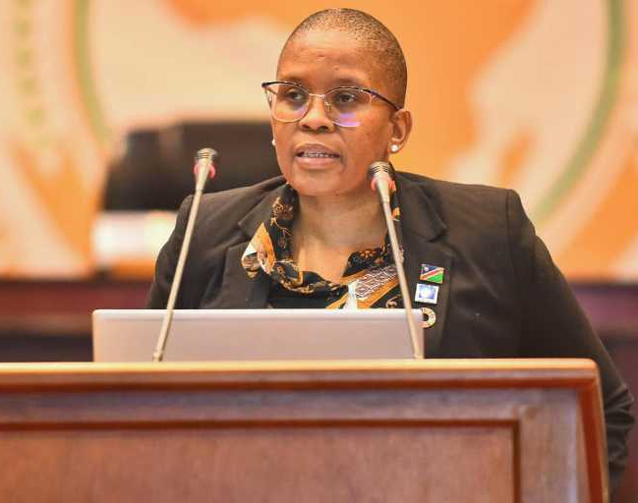
Yvonne Dausab (Namibia), Former Member of Parliament and Former Minister of Justice (2020-2025):
“Violence against women in politics is not a distant and abstract issue. It is in fact a harsh daily reality for countless women striving to contribute to the SADC and African political landscape. It’s a pervasive issue that undermines democracy and hinders the political participation of half of our population”.
Notes:
15

Slide 20
Thank You
This presentation was delivered at the 4th National Annual Prosecutors' Conference, Lusaka, Zambia, 16–18 March 2026.
Questions and Discussion
The floor is open. Your experience and insights as prosecutors, investigators, and legal practitioners are vital to advancing justice for women in Zambia's electoral processes.
For questions, further resources, or collaboration on TFGBV prosecution frameworks, please connect with the presenter.
Together, we protect democracy.
Presenter
Conference
Tapiwa Nyasulu · UNFPA Regional Gender and Human Rights Advisor
"Prosecutors as Sentinels of Democracy"
Notes:
16

