Slide 1
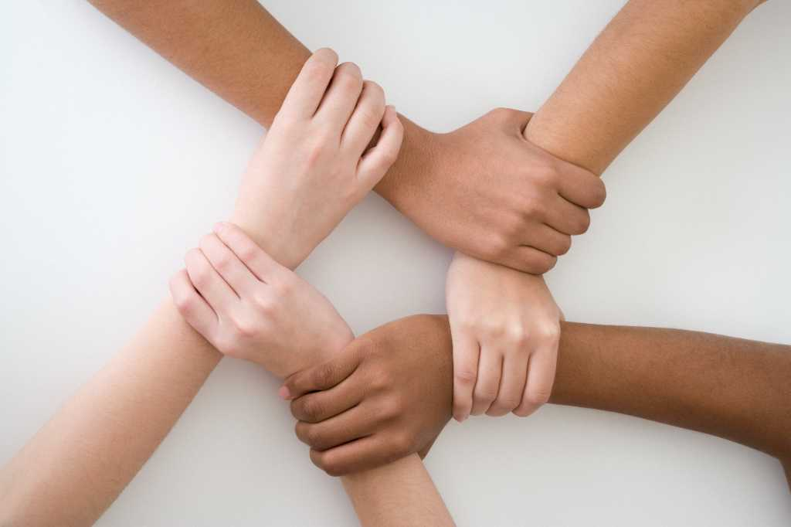
Paper presented by Women in Law and Development in Africa - WiLDAF Zambia at the 4th Prosecutors Conference 17th March, 2026 LUSAKA
The Critical Role of Women’ Participation in Democratic Dispensation

Slide 2
What is Democracy
Democracy is a framework of governance built on the principle that power resides with the people;
In a democracy, citizens including women exercise authority either directly or indirectly through elected representatives, ensuring that government decisions reflect the collective will of the people while protecting their individual rights;
Modern democratic governance relies on checks and balances, constitutional protections, citizen participation and institutions that prevent power concentration;
These elements create a framework where citizens can meaningfully influence government decisions through various participation mechanisms;
Democracy presupposes political equality, that everyone has equal rights to participate in democracy regardless of their background or gender;

Slide 3
Why Women Matter in a Democracy
Women are a critical players in any meaningful political dispensation, worldwide;
Women's participation in politics is crucial for strengthening democracy, fostering inclusive governance, and advancing gender equality;
Women participation in politics gives credence to the credibility of any democracy, acting as the “heart beat” of the system by ensuring the participation of the largest demographical group;
In Zambia, women constitute largest voting block - Of the 7,023,499 certified registered voters in 2021, 3,751,040 were female (53.41%) and 3,273,459 were male (46.59%);
Women participation directly influences policy priorities, shifting focus toward critical areas like social welfare, healthcare, and education;

Slide 4
Why Women Matter in a Democracy
Improved Policy Outcomes: Women in politics often prioritize issues that others overlook, including healthcare, education, childcare, and infrastructure. They are more likely to support legislation that supports families and promotes gender equality;
Economic Growth: Evidence shows that greater women's representation is linked to higher GDP growth. Women leaders often champion policies like paid family leave and childcare, which increase labor force participation, particularly among women;
Strengthened Democracy: Women's participation increases government accountability to women and other underrepresented groups. It enhances trust in government and encourages broader civic engagement

Slide 5
Why Women Matter in a Democracy
Effective and Collaborative Governance: Studies indicate that women in politics tend to work across party lines and are highly responsive to constituent needs, often making government more inclusive;
Lasting Peace and Reduced Corruption: Greater gender equality in government is linked to more sustainable conflict resolution and lower levels of human rights abuses. Studies also suggest that women’s leadership can help reduce corruption and improve public service delivery;
Role Modeling: Female political leaders act as role models, increasing the likelihood that women and girls will participate in political and civic life

Slide 6
The Case for Women in Zambia
Women in Zambian politics play a growing but still limited role, facing significant underrepresentation despite constituting over 51% of the population;
Voters vs. Candidates: Women constitute the majority of voters in Zambian elections, acting as a crucial force in legitimizing democracy, yet they are rarely selected as candidates by political parties;
Low Representation: Women hold only 15% of parliamentary seats (as of 2025) and roughly 8% of local government roles, falling short of regional African averages and SADC goal;
Key Positions: Despite low numbers, women have achieved high-ranking roles, including the first female Vice President and the appointment of the first female Speaker of the National Assembly, Nelly Butete Kashumba Mutti, in 2021;

Slide 7
The Case for Women in Zambia
The overall state of women political representation in Zambia is concerning, with the country failing to meet continental and international benchmarks - CEDAW), Maputo Protocol, SADC;
women make up 50.5 percent of Zambia’s population as well as the majority of voters, they remain systematically underrepresented in politics - Of the 7,023,499 certified registered voters in 2021, 3,751,040 were female (53.41%) and 3,273,459 were male (46.59%);
For period 2016 to 2021, out of 1,624 wards, 126 (7.8%) were women, 26 of 156 (16.7%) National Assembly, and 9 of the 22 (40%) seats at cabinet level while for the period 2021 to 2026, 141 of 1,858 wards were for women (7.6%), for the NA 21 of 156 (13.5%) and 5 of 24 cabinet seats (20.8%)

Slide 8
The Case for Women in Zambia
Despite this overall pattern of marginalization, women's parliamentary representation increased incrementally since the early 1990s, when the country reverted to multiparty democracy though the 2021 elections offered a different trend;
During the first democratic elections held in 1991, women won 7% of the seats;
This changed steadily over the years with 14 percent in 2006 and 17 percent in 2016;

Slide 9
Challenges
The EU Report on 2021 elections attributes the most recent decrease in women’s political representation to several factors, including violence ahead of the polls;
In Zambia, violence has often increased in the past ahead of crucial elections that led to a change of government, as happened in both
2011 and 2021.In both years, women’s political representation
decreased;
The challenges that candidates in rural areas faced in verifying the academic credentials needed to run for political office;
The emergence of the “Big man” syndrome in Zambian political parties, characterized by personal traits, often relegating women to “women wings of their parties”

Slide 10
Challenges
Overall, the obstacles to women’s representation in Zambia can be divided into three categories, structural barriers, legislative and policy challenges, and barriers related to electoral procedures and electoral processes;
Zambia’s patriarchal society represents a major structural barrier, traditionally assigning more power and resources to men than women;
A second set of challenges stems from the weaknesses in the legal and policy framework as well as the poor implementation of existing laws;
The male political leadership lacks commitment to implementing Zambia’s progressive constitutional provisions on inclusive governance.
Notes:
The resulting inequalities affect women’s access to education, job opportunities, and career progression, which directly impact the skills and resources needed for political mobilization; especially in a country where politics are heavily
monetized. provisions on inclusive governance.
For example, Zambian parties have failed to implement mandatory quotas for women: the two main parties
– the PF and the UPND – have both announced a goal of ensuring 40 percent female representation
in key internal structures, but have failed to realize this goal in practice.

Slide 11
Challenges
Third, electoral procedures managed by the electoral management body, the police, and the department responsible for issuing national identity and voter cards also disadvantage women;
For instance, the police sometimes fail to curtail election-related violence, especially violence committed by ruling party cadres;
poor election infrastructure (especially for the physically challenged),
the rushed distribution of national identity cards, and lack of civic education further impede women’s ability to vote on election
day.

Slide 12
Constitutional Amendments
Discussion on women participation in politics cannot be had without reference to Constitution of Zambia (Amendment) No. 13 of 2025, the brainchild of the infamous Bill 7;
The Bill objects itself to revise the electoral system for election to the NA to provide for a mixed-member proportional representation electoral system to guarantee the representation of women, youths and PWDs;
revise the composition of the National Assembly to provide for the increase in the number of constituency based seats from 156 to 226 to actualize the delimitation report by the ECZ;
To revise the number of nominated Members of Parliament, from 8 to 11;

Slide 13
Constitutional Amendments
By and large, Constitution (Amendment) No. 13 of 2025 represents an improvement to Constitution (Amendment) No. 2 of 2016 in so far as the representation of women in political processes is concerned largely due to the increased numbers at Parliamentary and local government levels;
The 2016 Amendment only offered 1 guaranteed seat in NA of the for women of the 168 potential seats 6% – Art. 82(3) on Deputy Speakers not members of same gender;
At local government, there was no guaranteed seat for women;
The 2025 Amendment now provides for 30 guaranteed seats for women, MMPR 40 seats, 20 women, of 15 Youth seats, at least 7 for females and at least 2 for PWDs (20, 7, 2) and the Deputy Speaker,

Slide 14
Constitutional Amendments
The NA shall have 226 constituency-based seats, 40 MMPR seats, 11 nominated Members of Parliament, Vice President, Speaker, and First and Second Deputy Speaker – Art. 68, bringing total to 281 seats, guaranteed 30 representing 10.7%;
Within context of comparing with previous constitutional order, this is commendable as we looking at 10.7% improvement outlook to the previous 6%;
However, within context of Zambia’s international commitments under the CEDAW, Maputo Protocol, SADC Protocol, guaranteeing 10.7% of the committed 50% is a notable failure of the system to seriously take women’ political participation serious;

Slide 15
Constitutional Amendments
While the Constitution under Art. 8 notes that National values and principles shall include equality and non-discrimination, the same Constitution offers a number of compromised provisions that gives a blanket cheque to power holders to undermine gender provisions;
For instance, Art. 259(10(b) provides that all appointments or nominations to public offices should ensure 50% of each gender is nominated or appointed from the total positions available, UNLESS IT IS NOT PRACTICAL TO DO SO;
In Art. 69 (1), dealing with nomination as MP, the Constitution uses a discretional term of “MAY” for the 11 MPs to be nominated taking into account special interests, skills, or gender

Slide 16
Constitutional Amendments
Sec36D(1)” Councils under the proportional representation electoral system shall consist of the following:
a) 2 women, 1 youth and 1 PWD for a council with 20 ward-
based seats and below;
b) 3 women, 2 youths and 1PWD for a council with 20 to 30
ward-based seats; or
c) 4 women, 3 youths and 2PWDs for a council with 31 or
more ward-based seats.

Slide 17
Gender Machinery Aspect
The gender machinery is an important aspect top enhancing women’ participation in the political process;
Despite the Constitution establishing the Gender Equity and Equality Commission – Art. 231, this is yet to be operationalized 10 years after the amendment of the Constitution;
Part 18 establishing Commissions, 16 and only 3 missing;
GEEC is an important vehicle to promoting the effective and meaningful participation of women in Zambia, essentially due to its inherent role as a quasi-judicial entity; that may hold political players to account for not actualizing legal provisions on women participation; Sections 14, 24, 29 of GEEA;

Slide 18
The END
THANK YOU FOR YOUR ATTENTION

